Slide 1
Environment Design

Slide 3
Pipeline/Process Caveats
There is no single best practice
The Pipeline will and must evolve
Oh so many variables

Slide 4
Two Principal Roles
Architect
Finishing Artist
Collaboration and Iteration at every stage

Slide 5
Mission Conception
Broad timeline for the game
Napkin sketch
Concept Art
Whiteboard

Slide 6
Broad Timeline

Slide 7
Napkin Sketch

Slide 8
Concept Art

Slide 9
Whiteboard
Notes:
Design Considerations
- themes
- pacing
- introductions
- sandbox
- branching vs. linear
- story
Art Considerations
- scale
- tone
- palette
- architectural form language

Slide 10
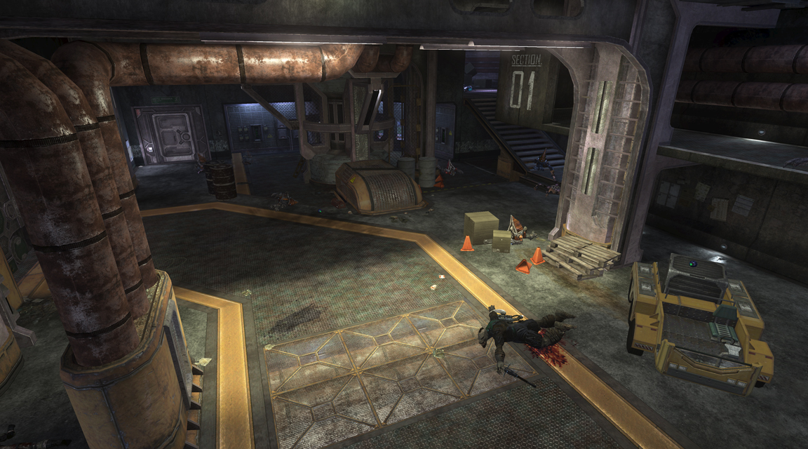
Space Design Case-Study

Slide 11
Aspect 1: The Hook
Strong layout concept that makes the space unique
Forces an orientation
Easy-to-grasp and navigate
Suggests a specific tactic or type of game-play
Notes:
Force an Orientation - One-way Asymmetry Simple asymmetry to the terrain or structure can make a space both more interesting to fight in and it can prevent players from getting lost. It’s made even better when that asymmetry is formed from a prominent feature, such as a cliff, river, or giant window. This will allow players to reorient themselves after being turned around in the heat of combat.
Make Easy to Grasp and Navigate - Strong layout divider. Some feature of the space allows one to mentally define one part from another. Inside vs. outside. Tight area vs. exposed area. Dark side vs. light. Imagine playing co-op over Live and having to tell your partner where you were. It’s the difference between being able to say “I’m out on the perimeter walkway” and “I’m in the place with gray walls and some structural things”.
Suggest Specific Tactics or Gameplay Obvious strong position -these are spaces that lend themselves to assault and defense. A single stronghold with numerous avenues of attack.
Obvious weak position -Weak points may just be the ass end of strong positions. Gameplay suggested may include escape scenarios, or more cautious advancement against an opposing force.
Long distance combat- these spaces encourage long range combat by providing long views and limited cover in the killing field. In addition, the connectivity often prevents the player or AI from
quickly closing the distance. Close quarters combat - these are spaces where the player expects to find trouble right up in his face. Cover is often very dense and you frequently can’t see what’s waiting around the corner.)

Slide 12
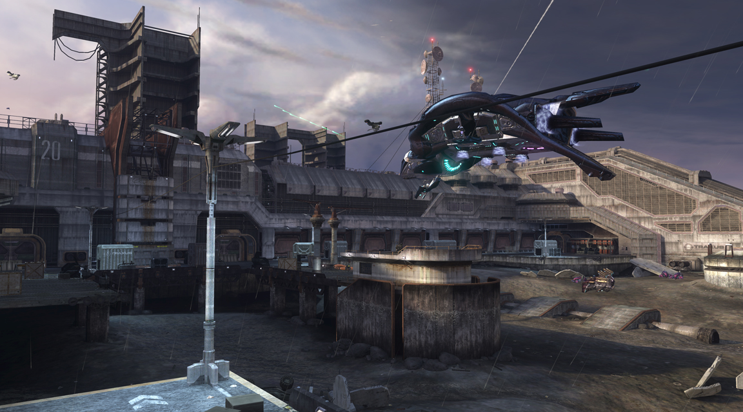
The Hook

Slide 13
Aspect 2: Scale
An informed idea of how large the space needs to be
Capacity
Engagement Range

Slide 14
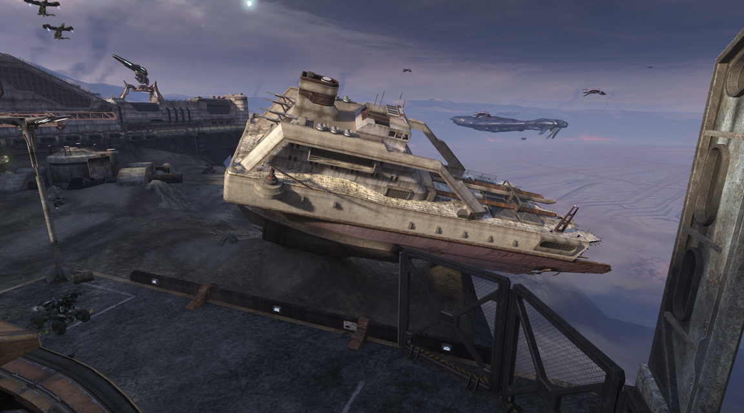
Scale

Slide 15
Aspect 3: Combat Elements
Fronts
Layers
AI Blinds
Cover

Slide 16
Fronts
Notes:
The “Front” - is the line of battle between the player and his enemies. It is created by the paths and cover in a space. On one side of the Front is the Safe Territory. This is the area of a space that the player can safely retreat to if he starts to get overwhelmed in a fight. There should ALWAYS be sufficient cover in the safe territory for the player to recharge his shields. This should also be where the player enters the space, nearly all of the time. On the other side is the Enemy Territory where the enemy AI has total control and it is very dangerous for the Player. This is nearly always where the exit of the space is found. Most of the combat, however, happens in the Killing Ground, the area in the middle. Sight lines in this area should be clear enough that the player can see the battle playing out and changing. If the AI retreats, the player should be able to tell.

Slide 17
Layers
Notes:
Layers are areas within a space that cannot be moved between trivially. These layers are used together during combat, so they are not considered separate spaces. Layers can also be created when two consecutive areas have dramatically different gameplay, like a vehicle exterior near an infantry interior. Combat can still occur between the layers, but the player will employ very different tactics depending on which layer he is in. Balcony Layer, Chasm Layer etc.

Slide 18
AI Blinds
Notes:
AI Blinds are environment features that allow the player to move a short distance without the AI being able to see him. They are used to:
• Hide and recover shields after taking too much damage
• Force the AI to search for you
• Attack an enemy from an unexpected direction
Every space should have AI blinds. And they are best when they allow the player to switch between two territories (retreating from the Killing Ground into Safe Territory) or between two layers.
Examples: Perimeter Blind, Loop Blind, Center Blind, Ledge/Hill Blind, Cover Blind

Slide 19
Cover
Notes:
Cover Groups - In order to add shape and texture to a fight, the cover in a space should be grouped. These groups will naturally be used as Safe Territory or Enemy Territory, and the spaces between them will make good Killing Grounds. Examples: Tall Cover Cluster,Short Cover Cluster, Ledge/Hilltop Cluster, Thick Clusters, Thin Clusters. Aesthetics of cover, crates, jump hints, vaulting, dynamic, destructible, bushes

Slide 20
Aspect 4: Movement Elements
Player Shortcuts
One-way Paths
Ninja Paths
Vehicle Flow
Notes:
Player Shortcut Paths - these are routes that the AI cannot normally take, but the player can. They usually take less than 5 seconds to traverse, and they are best when they connect two territory-types or two layers. They are also often AI blinds. Every once in awhile, the AI will use these paths through hints or scripting, which makes the AI seem more lifelike and intimidating.
One-Way Paths - These are paths that require the player to commit to a course of action and don’t allow him to retreat. They very often lead directly into Enemy Territory and can lead to a successful flanking…or a quick death. The player must jump down from a ledge or balcony and cannot jump back up to escape.
Ninja Paths - Some paths are just fun. They make the player feel like a ninja. Usually they do not shorten the time it takes to get somewhere (often they take longer than a direct path) but they
are just cooler. Sometimes they allow the Player to attack from an unexpected direction, as well. Jump chains, crouch-jumps.

Slide 21
Movement
Notes:
Player Shortcut Paths - these are routes that the AI cannot normally take, but the player can. They usually take less than 5 seconds to traverse, and they are best when they connect two territory-types or two layers. They are also often AI blinds. Every once in awhile, the AI will use these paths through hints or scripting, which makes the AI seem more lifelike and intimidating.
One-Way Paths - These are paths that require the player to commit to a course of action and don’t allow him to retreat. They very often lead directly into Enemy Territory and can lead to a successful flanking…or a quick death. The player must jump down from a ledge or balcony and cannot jump back up to escape.
Ninja Paths - Some paths are just fun. They make the player feel like a ninja. Usually they do not shorten the time it takes to get somewhere (often they take longer than a direct path) but they
are just cooler. Sometimes they allow the Player to attack from an unexpected direction, as well. Jump chains, crouch-jumps

Slide 22
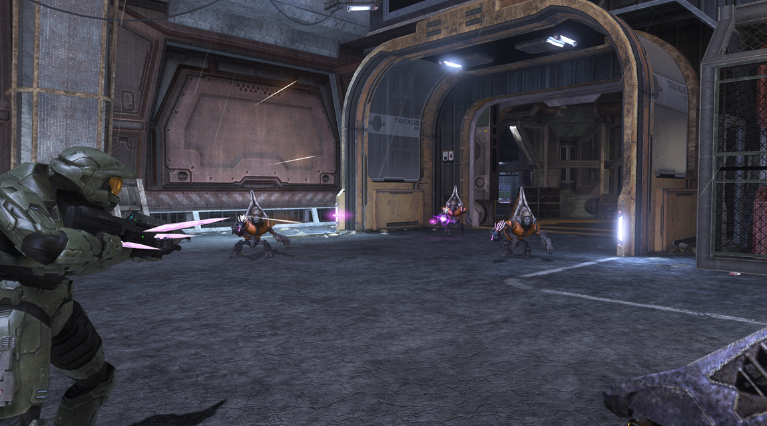
Encounter

Slide 23
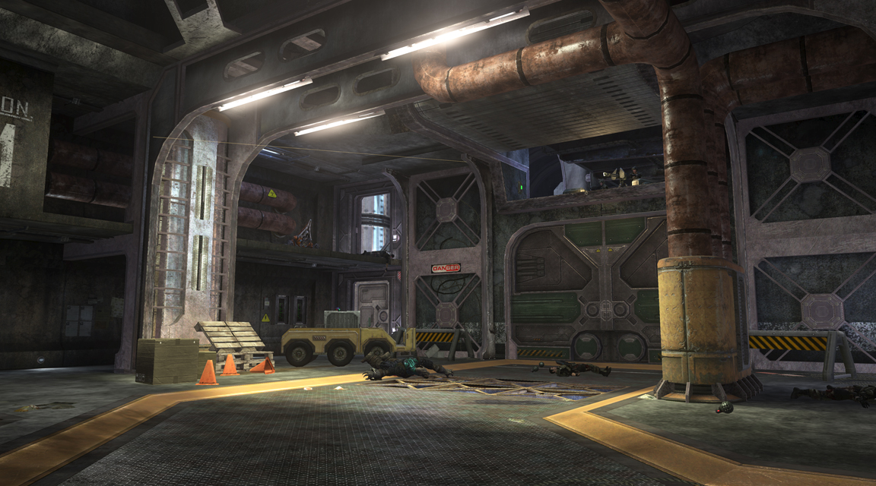

Slide 24
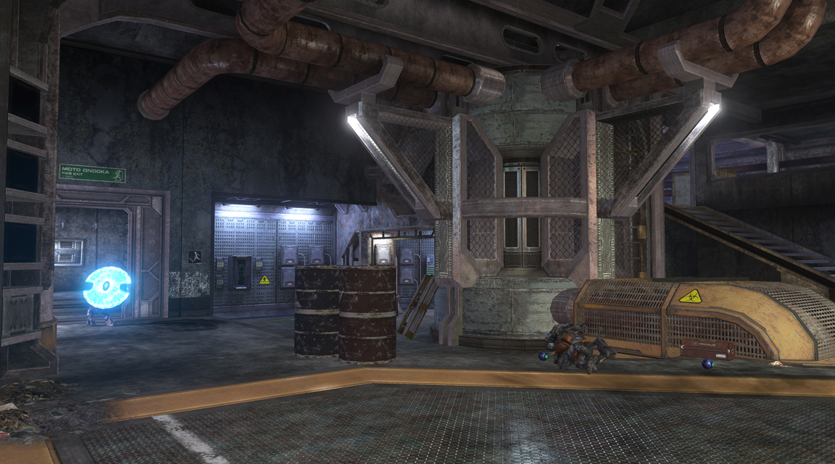

Slide 25
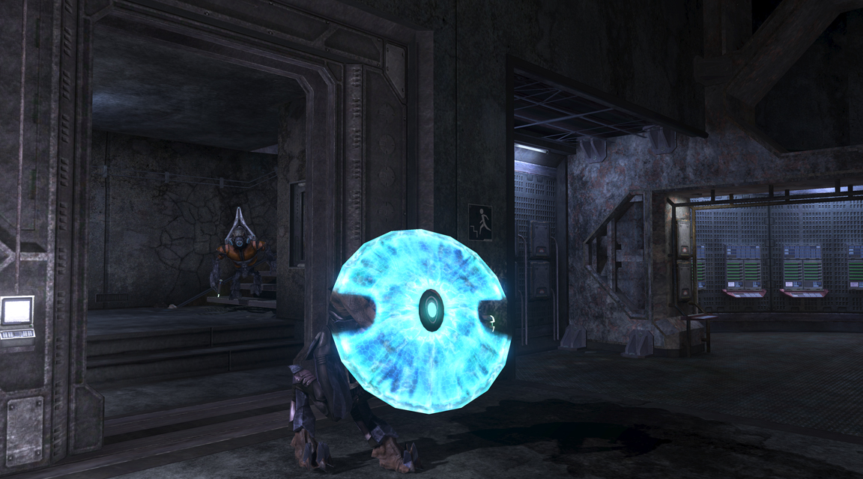

Slide 26
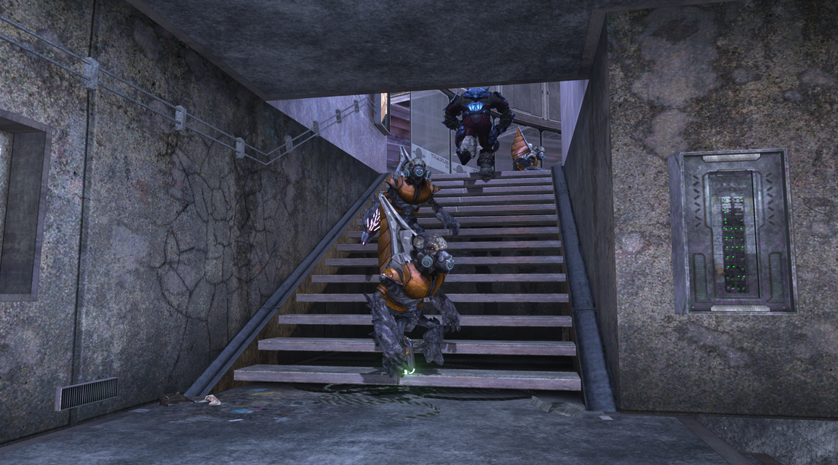

Slide 27
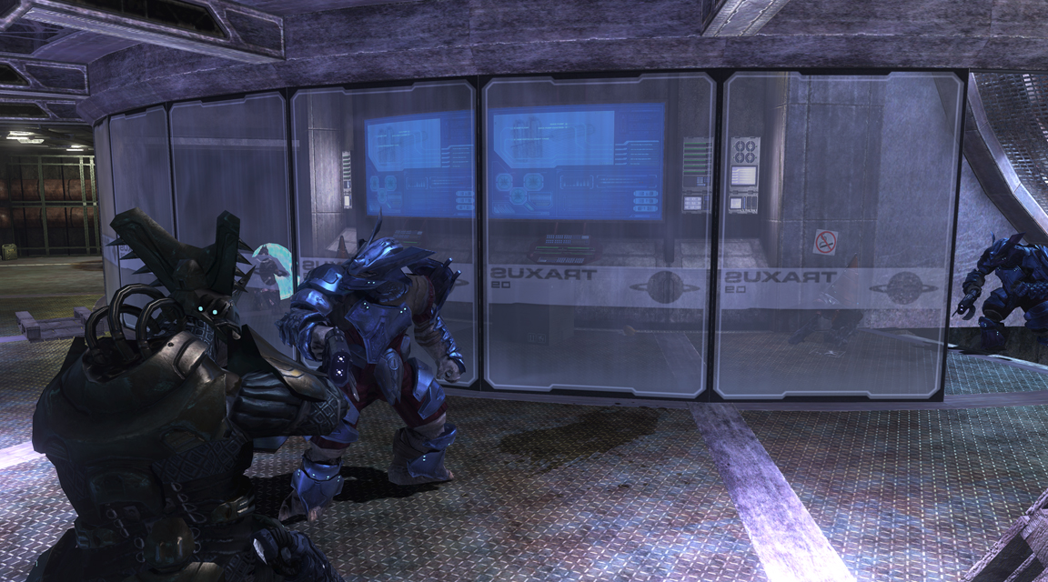

Slide 28
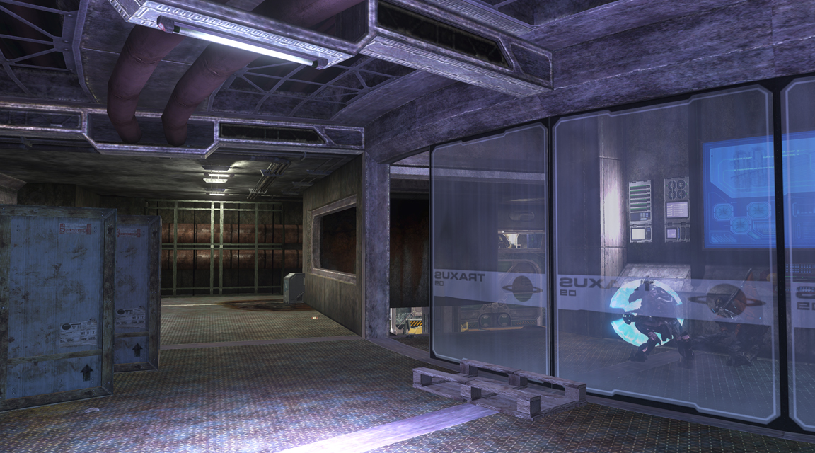

Slide 29
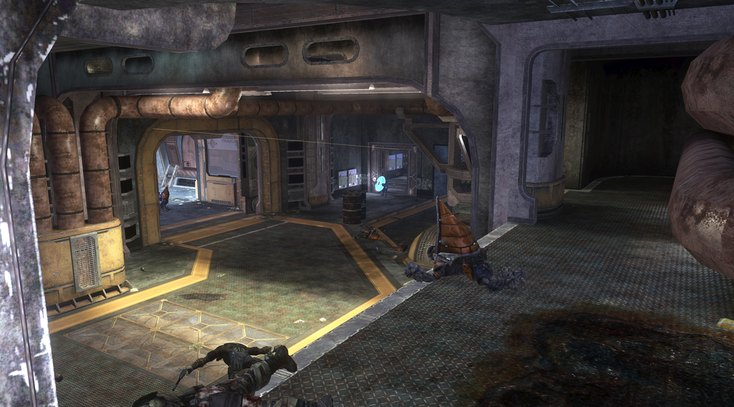

Slide 30
Concept Art
Notes:
Concept Art

Slide 31
Notes:
This point we are not worried about color. Story was not flushed out. So we just had some fun and brainstormed forms and other types of concept.

Slide 32
Notes:
More fast thumbnails and form study. Not really concerned about color. On a high level we don’t know the finished story or gameplay. Still blue sky phase.

Slide 33
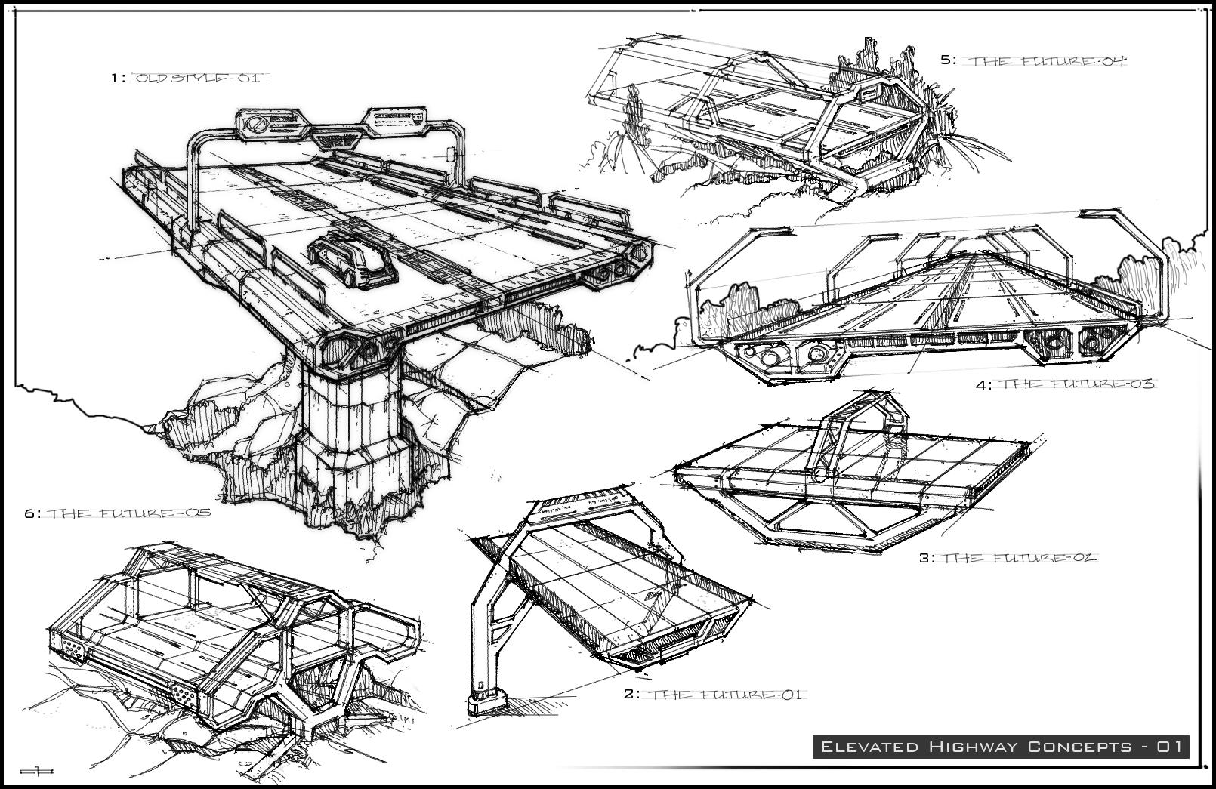
Notes:
We started to know about story elements, and we started to narrow down some of the elements we needed. So I was able to concept out ideas of things we knew we were going to have.

Slide 34
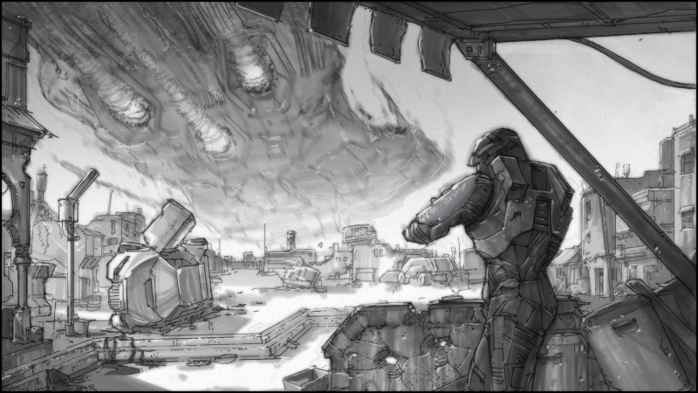
Notes:
More study.

Slide 35
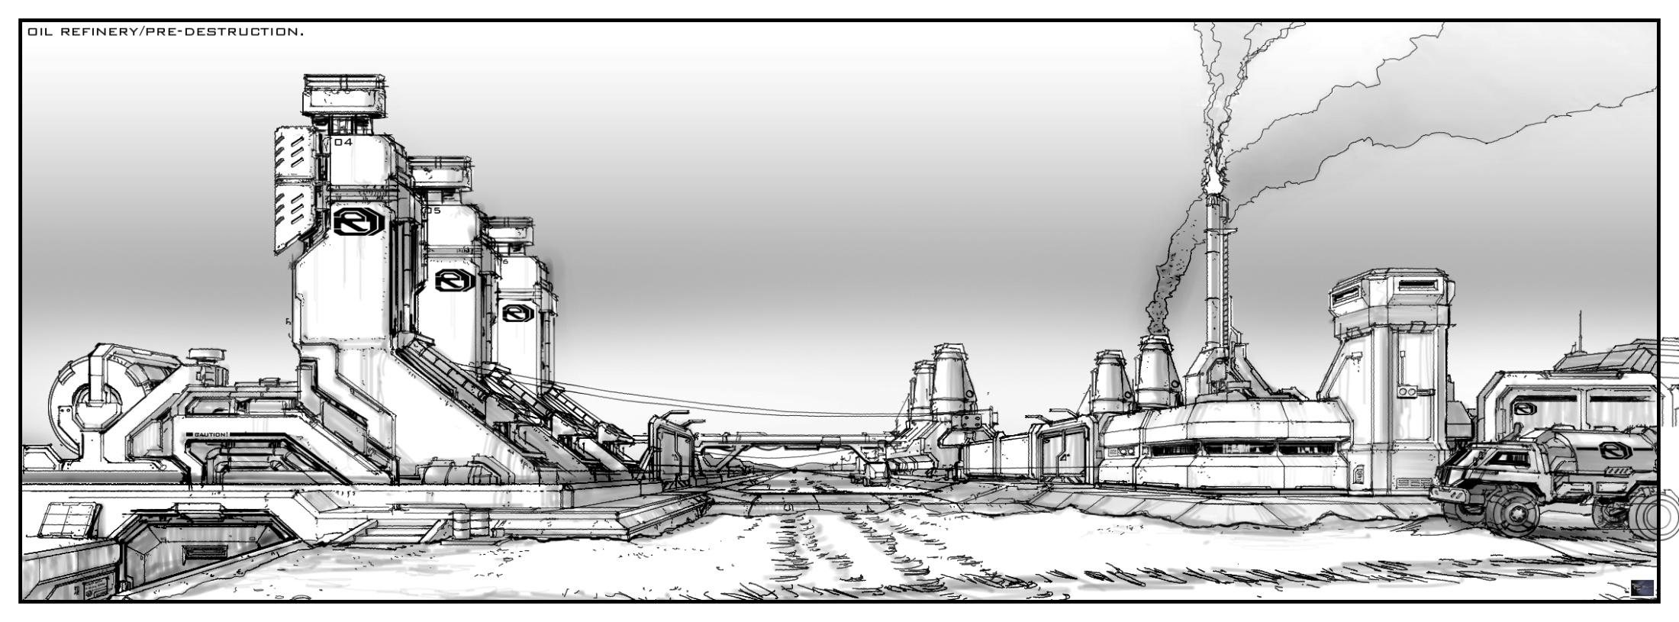
Notes:
More study. This is an old version of worker town where the gun was going to be placed. This was before e3. so we did not develop the cliffside idea yet.

Slide 36
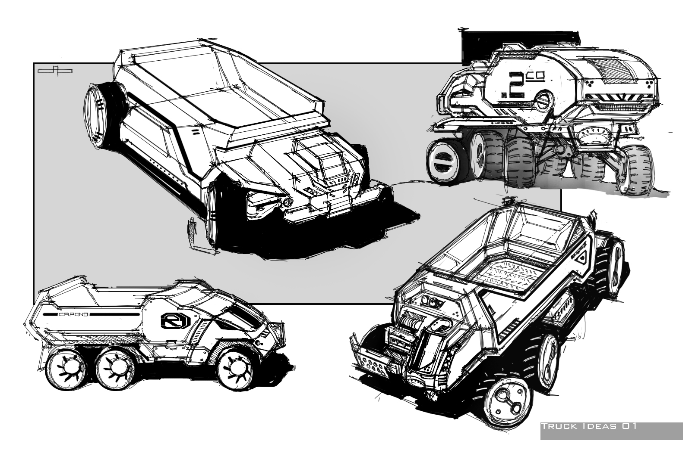
Notes:
Early industrial vehicle study.

Slide 37
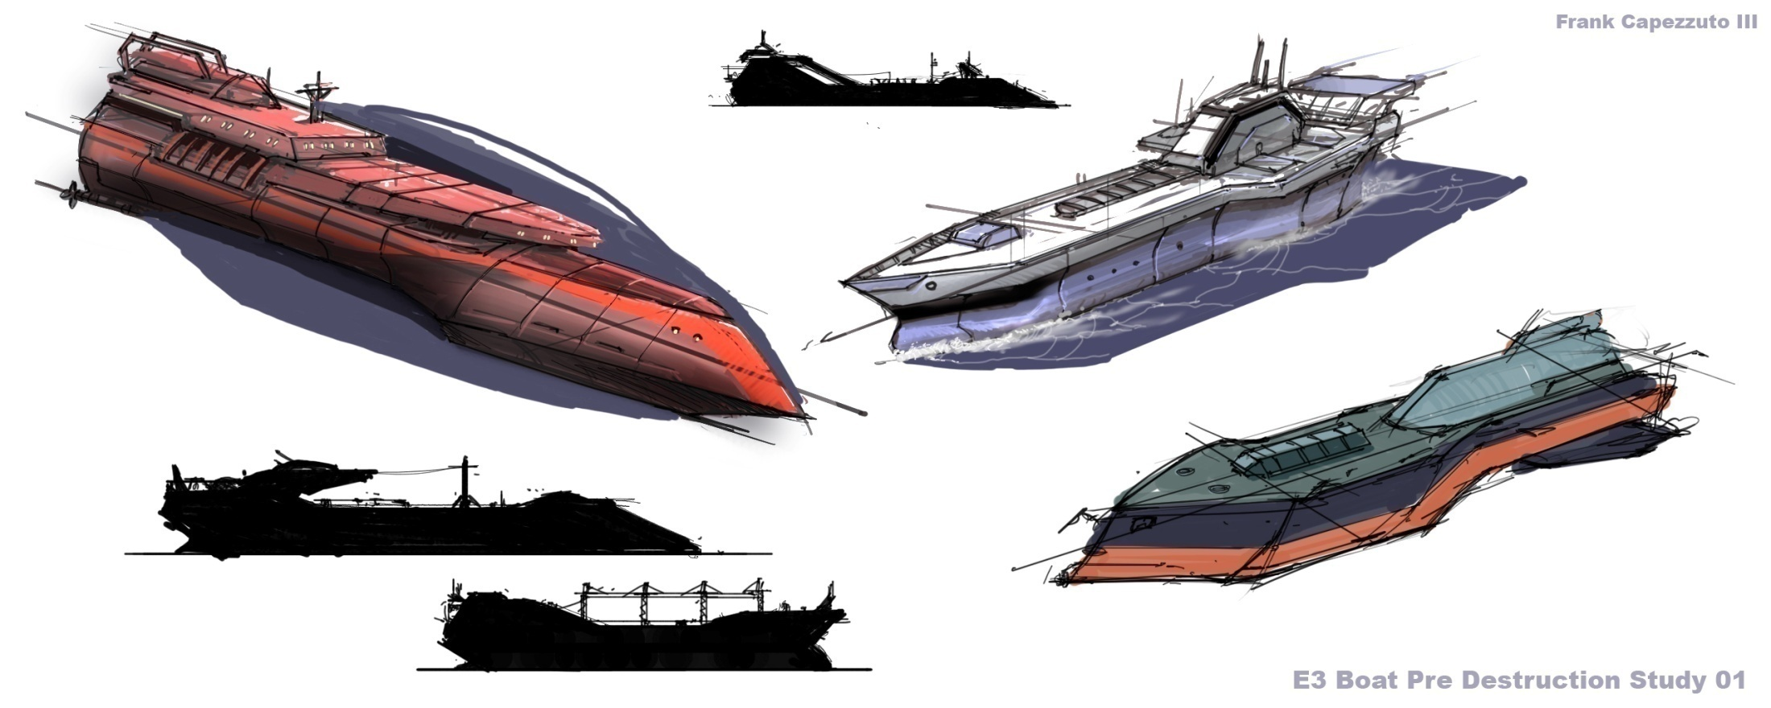
Notes:
Crashed tanker pre destruction study.

Slide 38
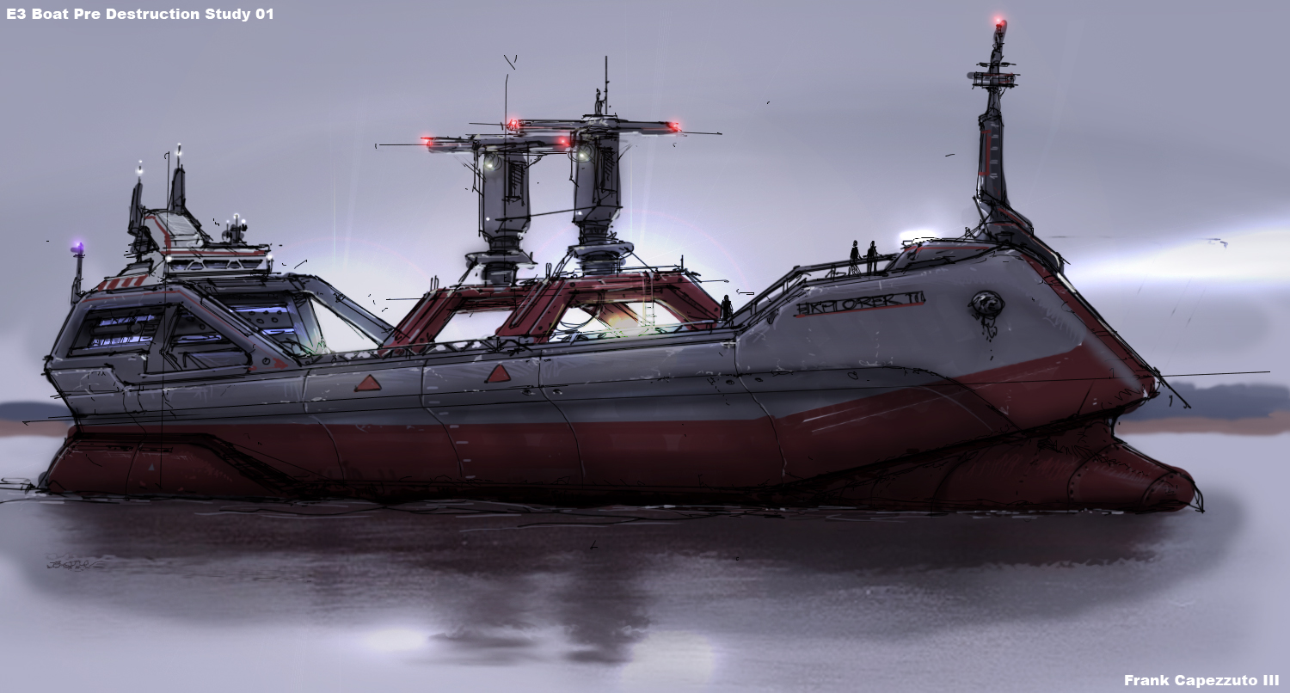
Notes:
Crashed tanker pre destruction study.

Slide 39
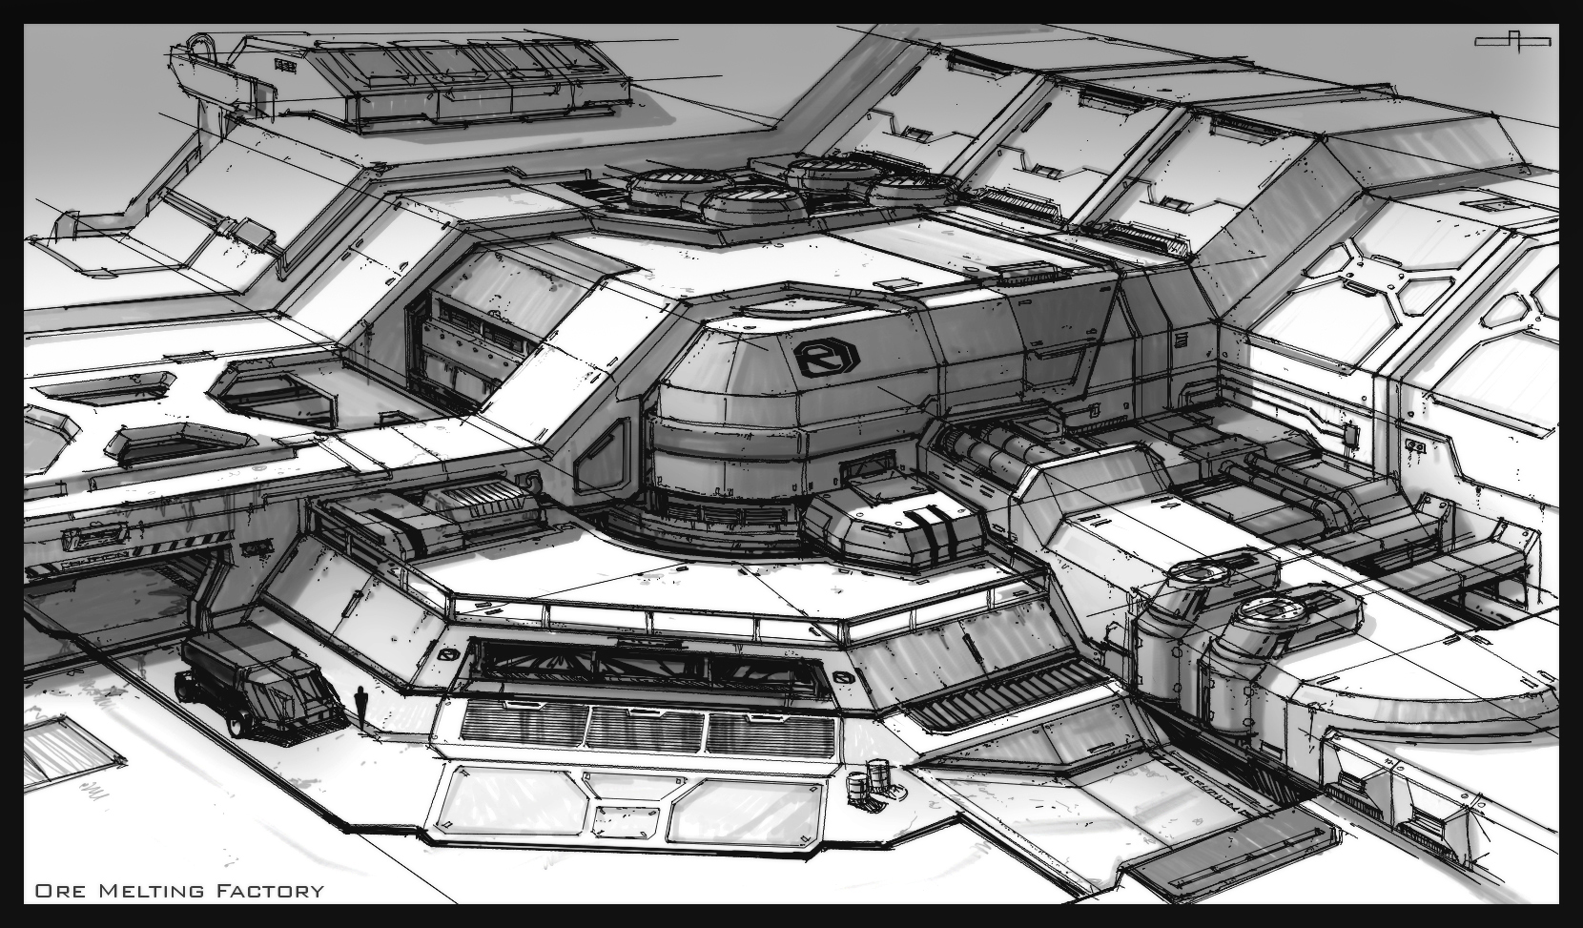
Notes:
Starting to get a betting idea of form and what we were doing with structure.

Slide 40
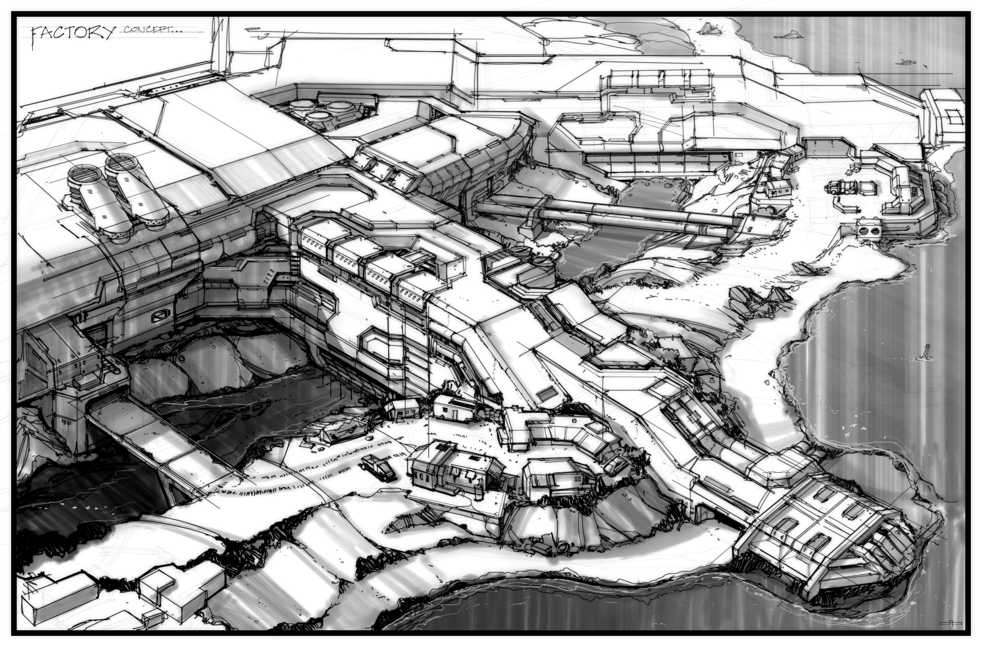
Notes:
Starting to get a betting idea of form and what we were doing with structure. This is a factory arm concept.

Slide 41
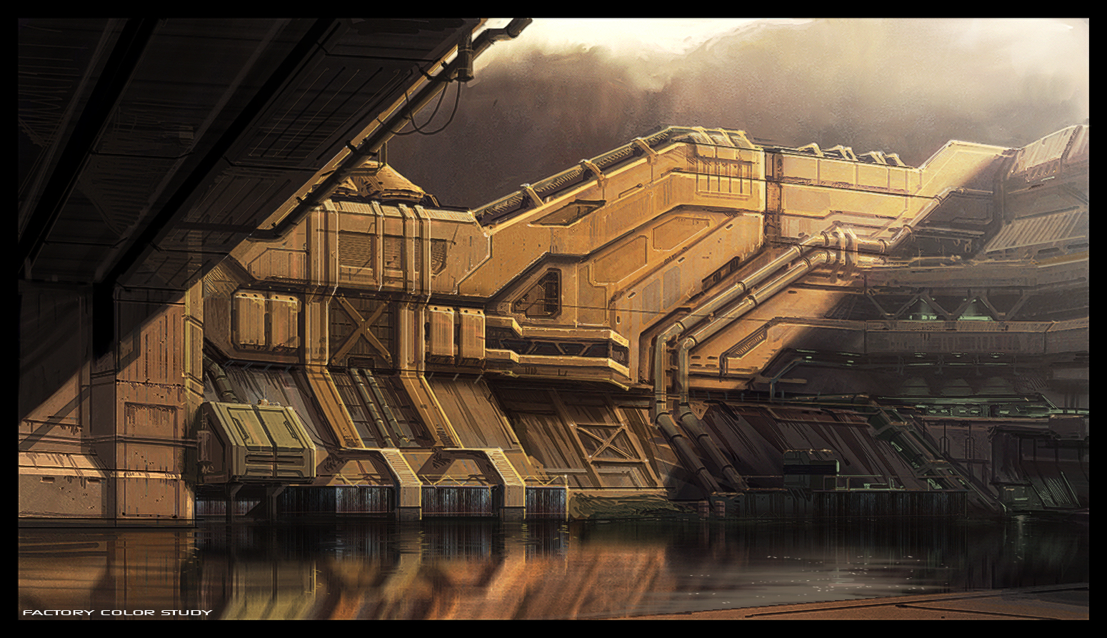
Notes:
Better understanding of structure, started to study light and color.

Slide 42
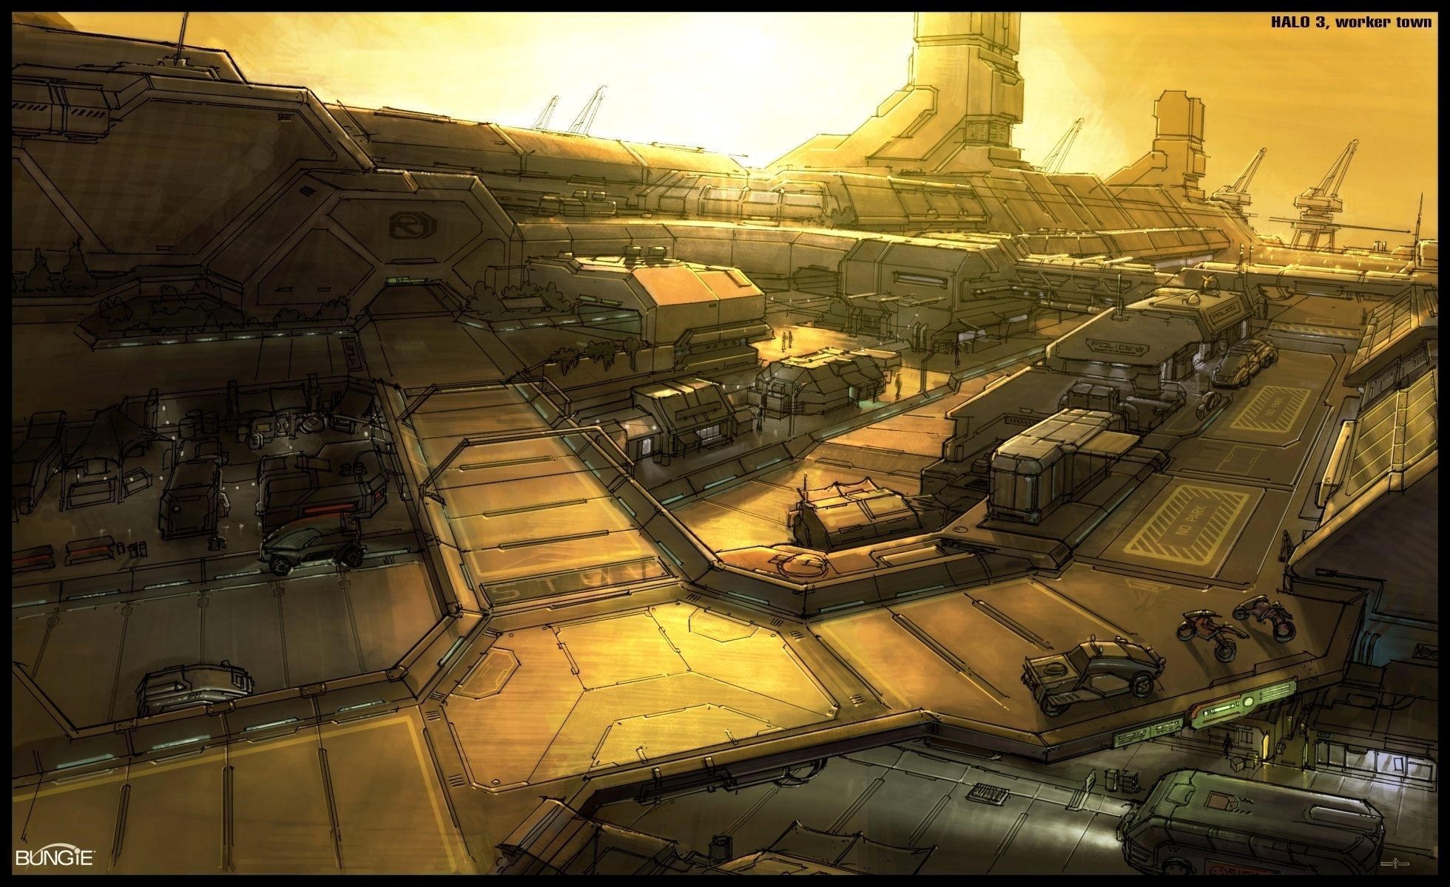
Notes:
Better flushed out idea of what voi was going to be. At one point we had a ‘workertown’ area. Kind of like a market of the future. We went away from this idea just to include generic industrial buildings for production sake.

Slide 43
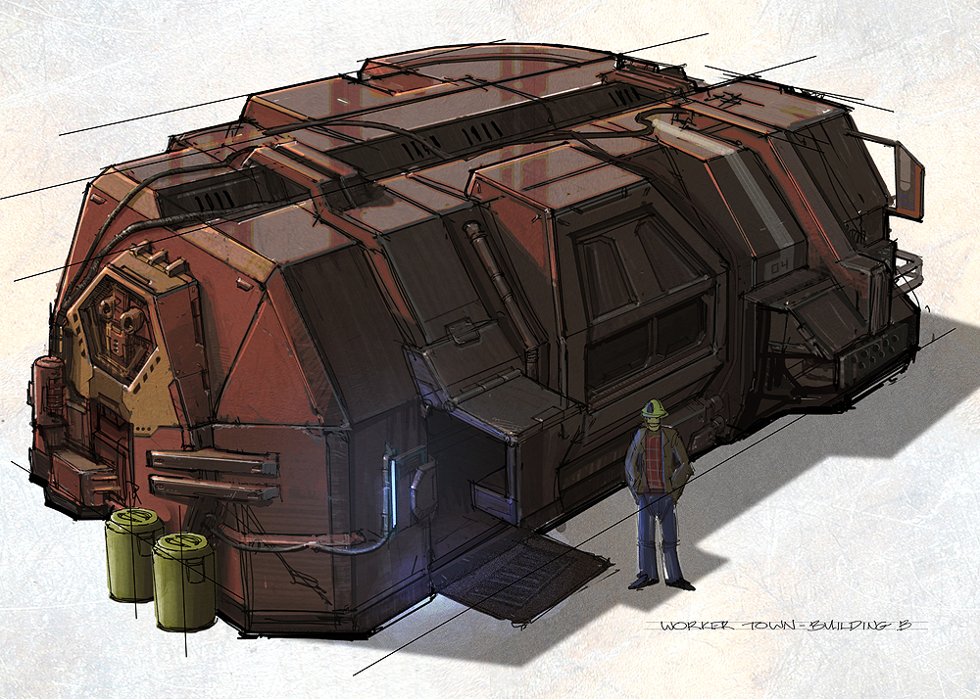
Notes:
Old modular ‘market’ building for the worker town.

Slide 44
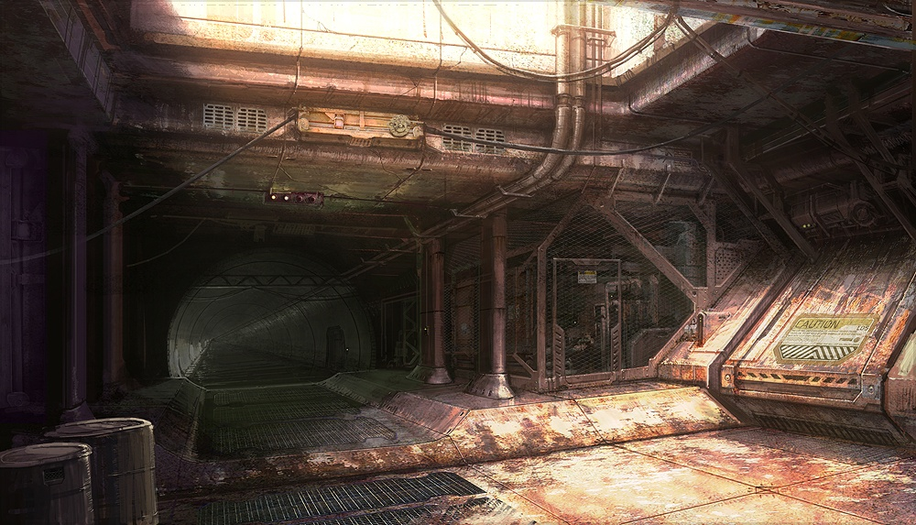
Notes:
Factory arm concept. We ended up going with this design in the final game.

Slide 45
Production

Slide 46
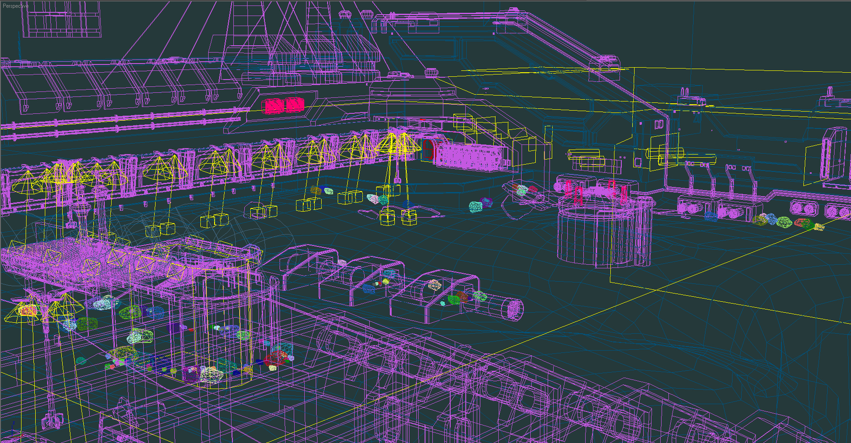
Notes:
First we start with more or less a wireframe, non shaded in max. rough out forms around designer massout. At this point artist can change layout if need be. It’s pretty open at this point.
Artist and designers are free to ‘mold’ environent at massout stage.

Slide 47
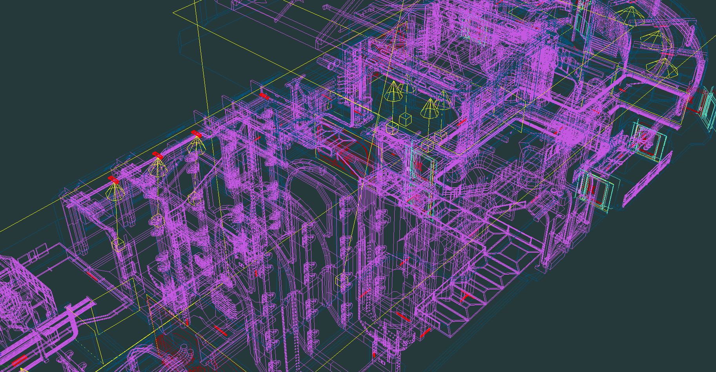

Slide 48
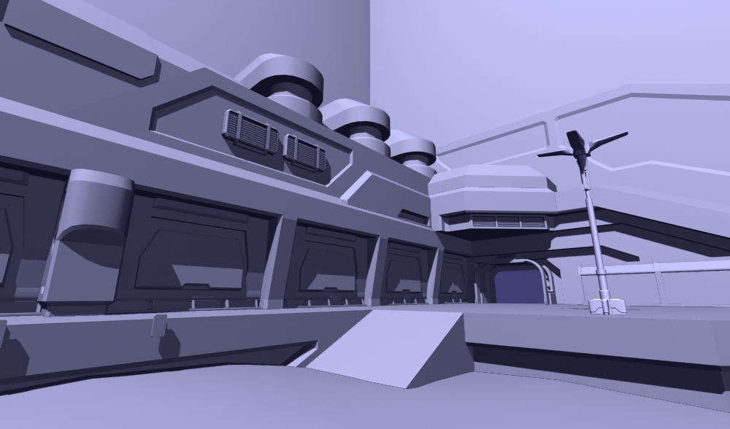
Notes:
Architecting stage. Massout is finished, so we start working in some near finished forms. Layout should not change at this point.

Slide 49
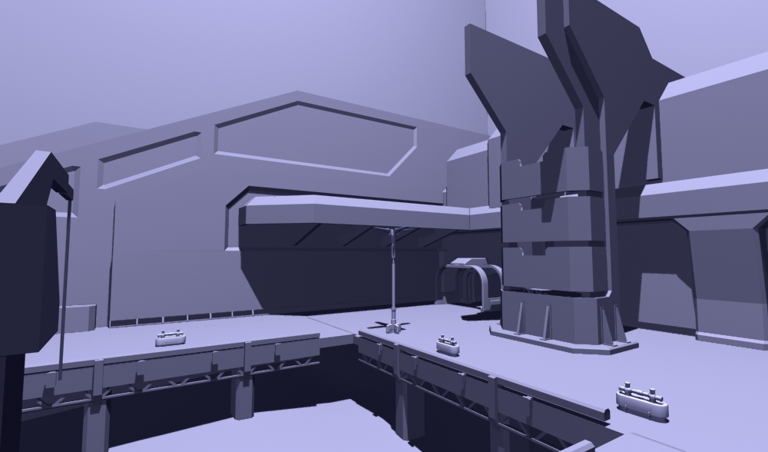

Slide 50
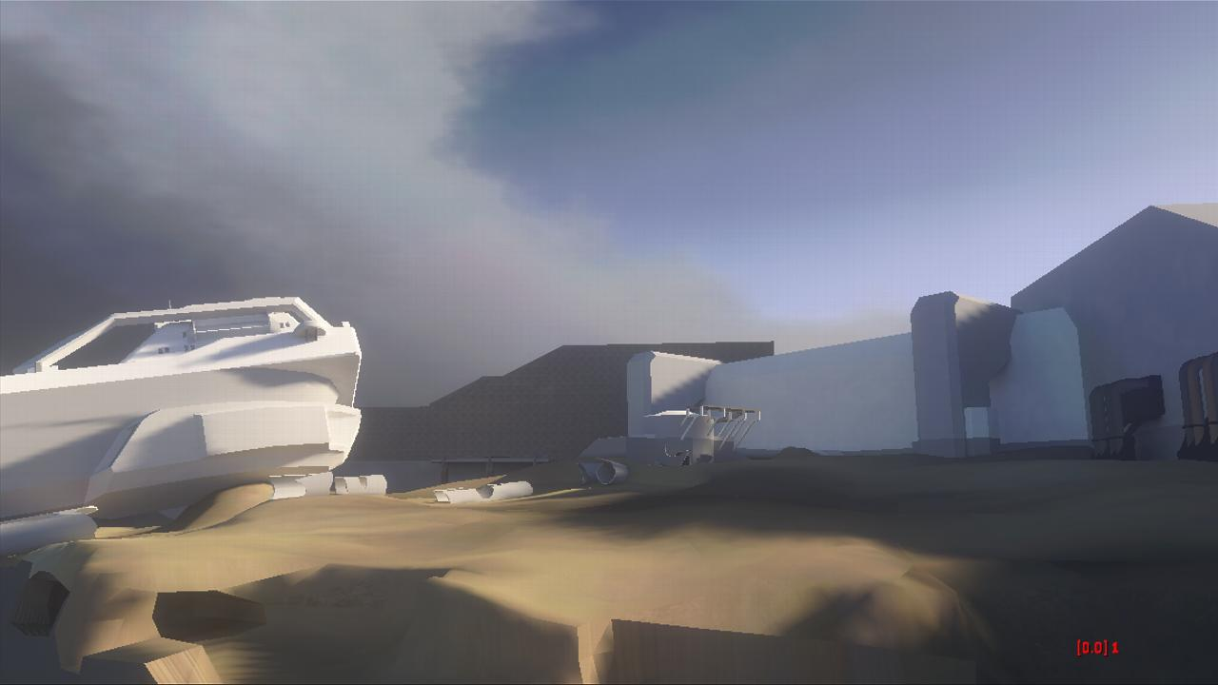
Notes:
Start adding lighting, general material types. At this stage we can play it.

Slide 51
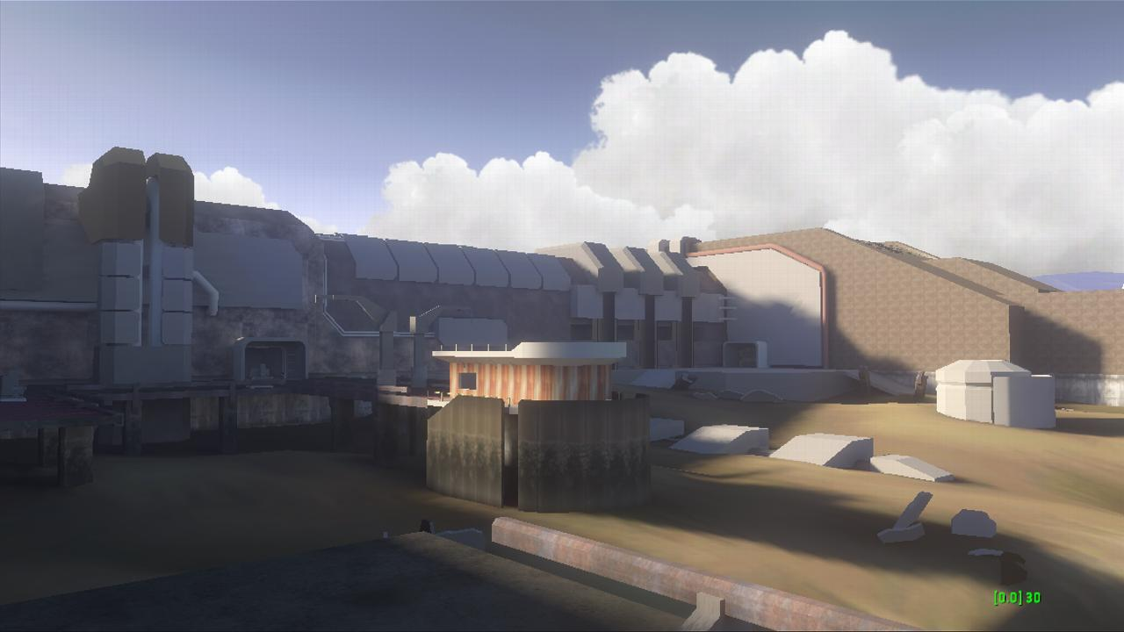

Slide 52
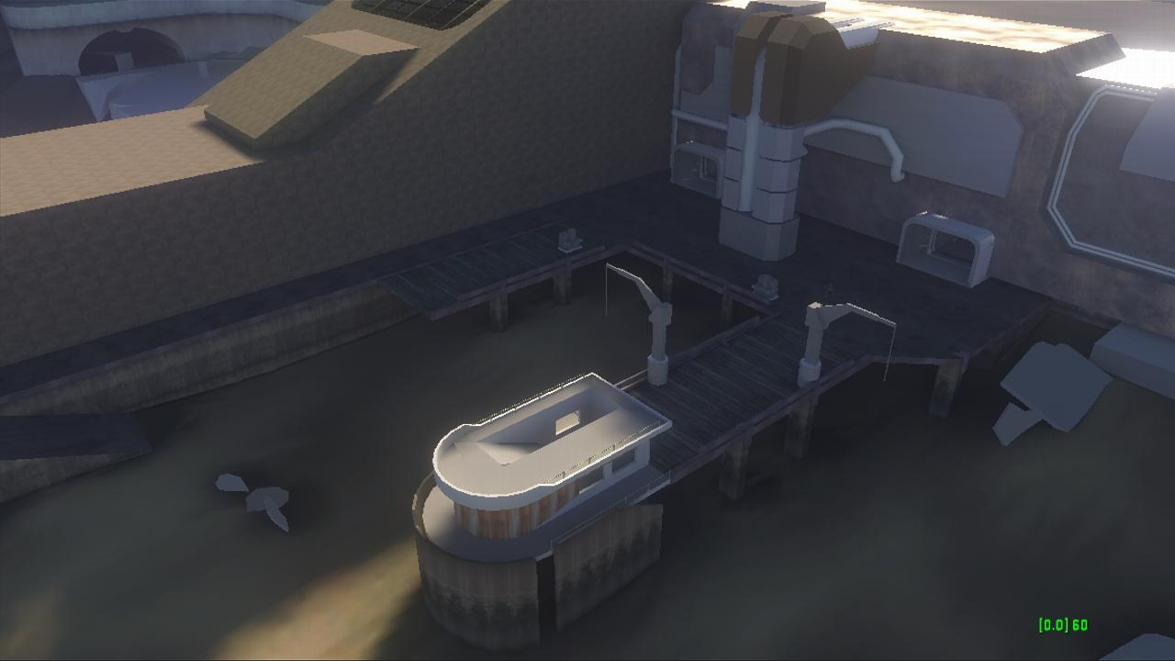

Slide 53
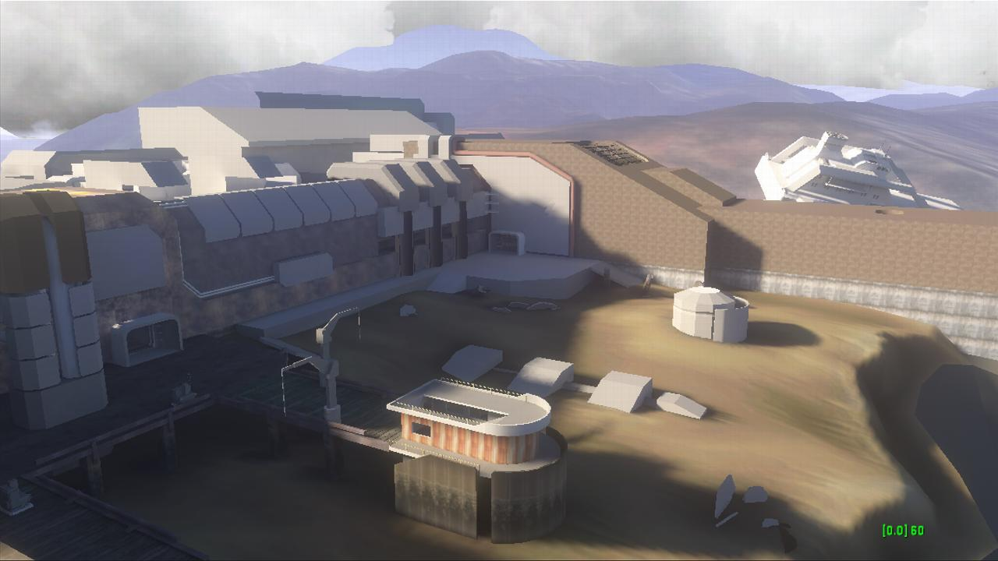

Slide 54
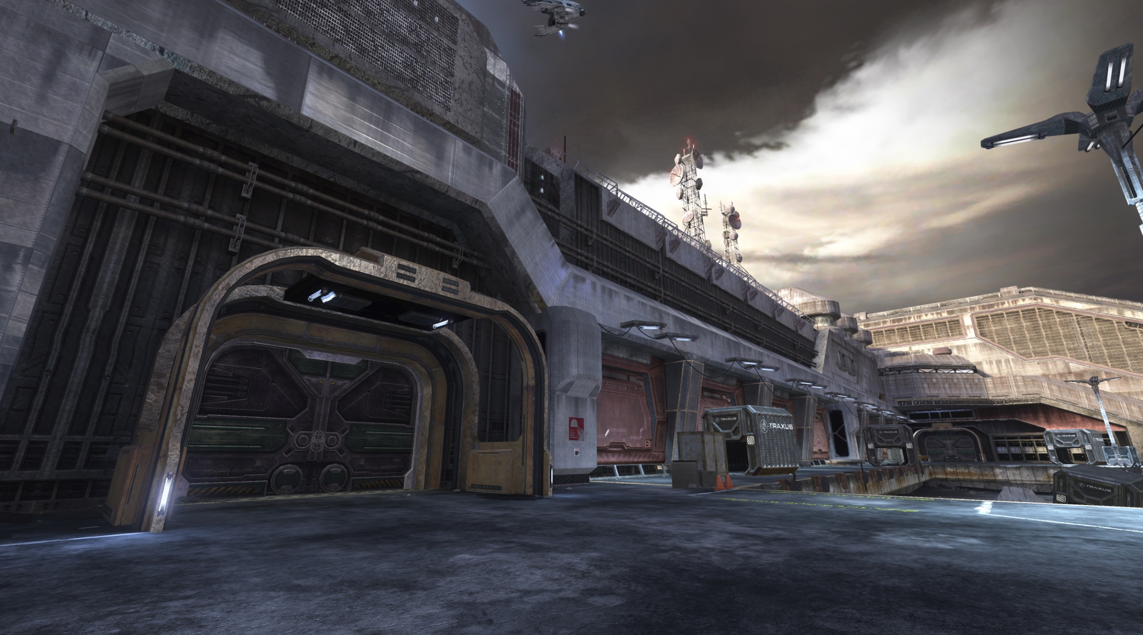
Notes:
Near finished product. We fix bugs and do last pass at decals, lighting and hyper detail. Most environment and bsp geometry is set. We may do a last pass at shaders. This is content complete, so we are not adding any new environment shaders and bitmaps. Tweak what we have.

Slide 55
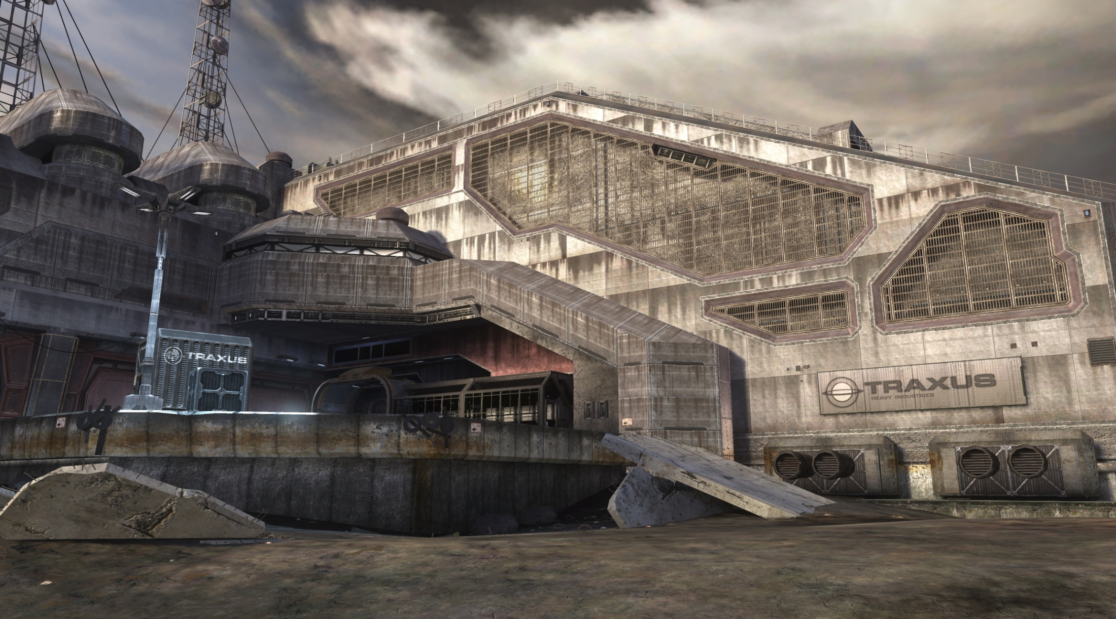

Slide 56
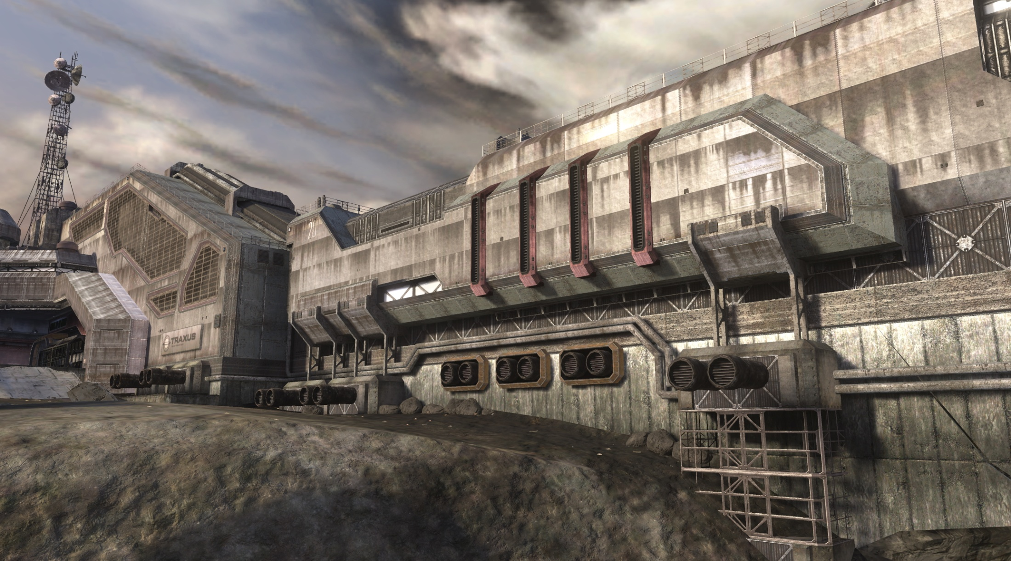

Slide 57
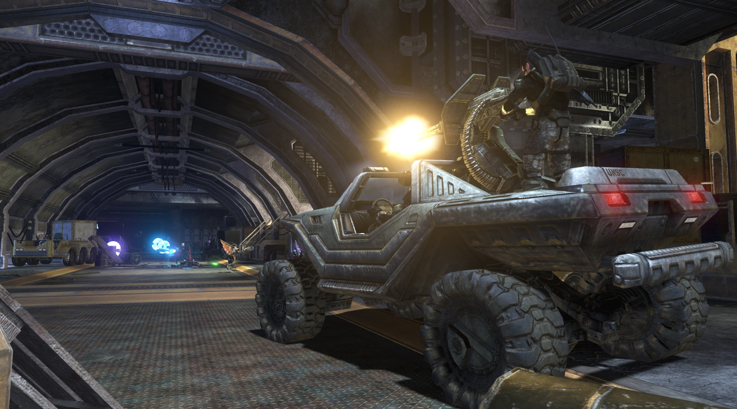

Slide 58
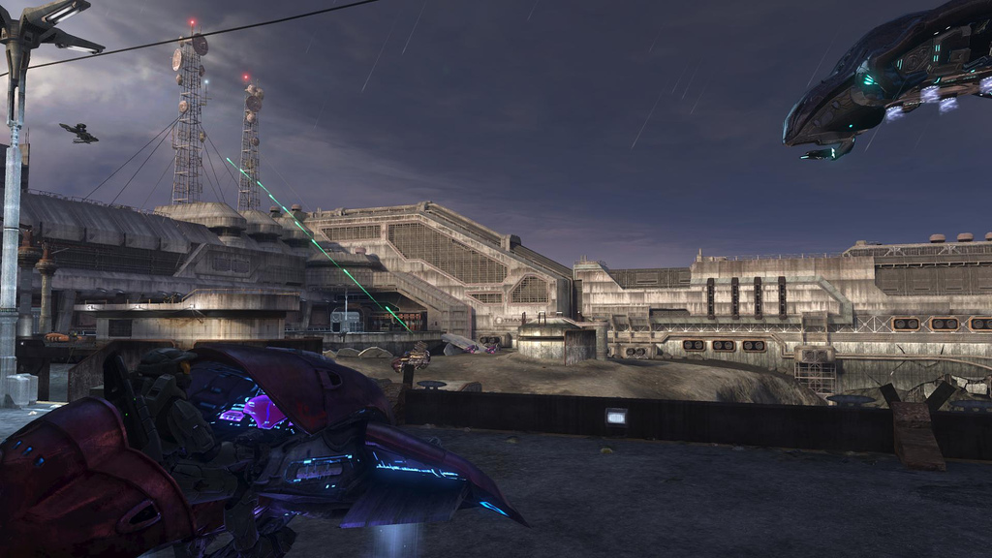

Slide 59
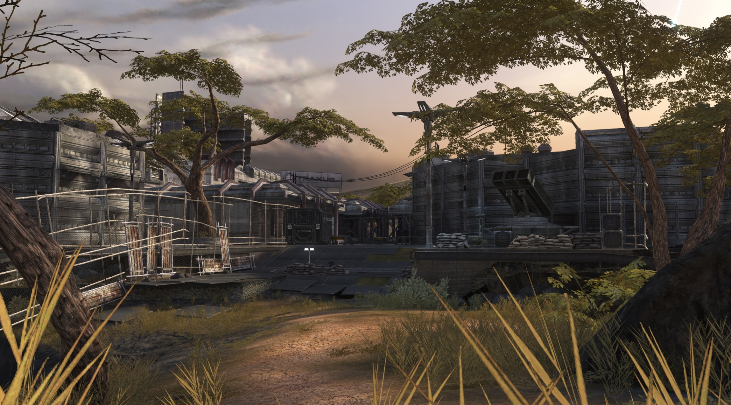

Slide 60
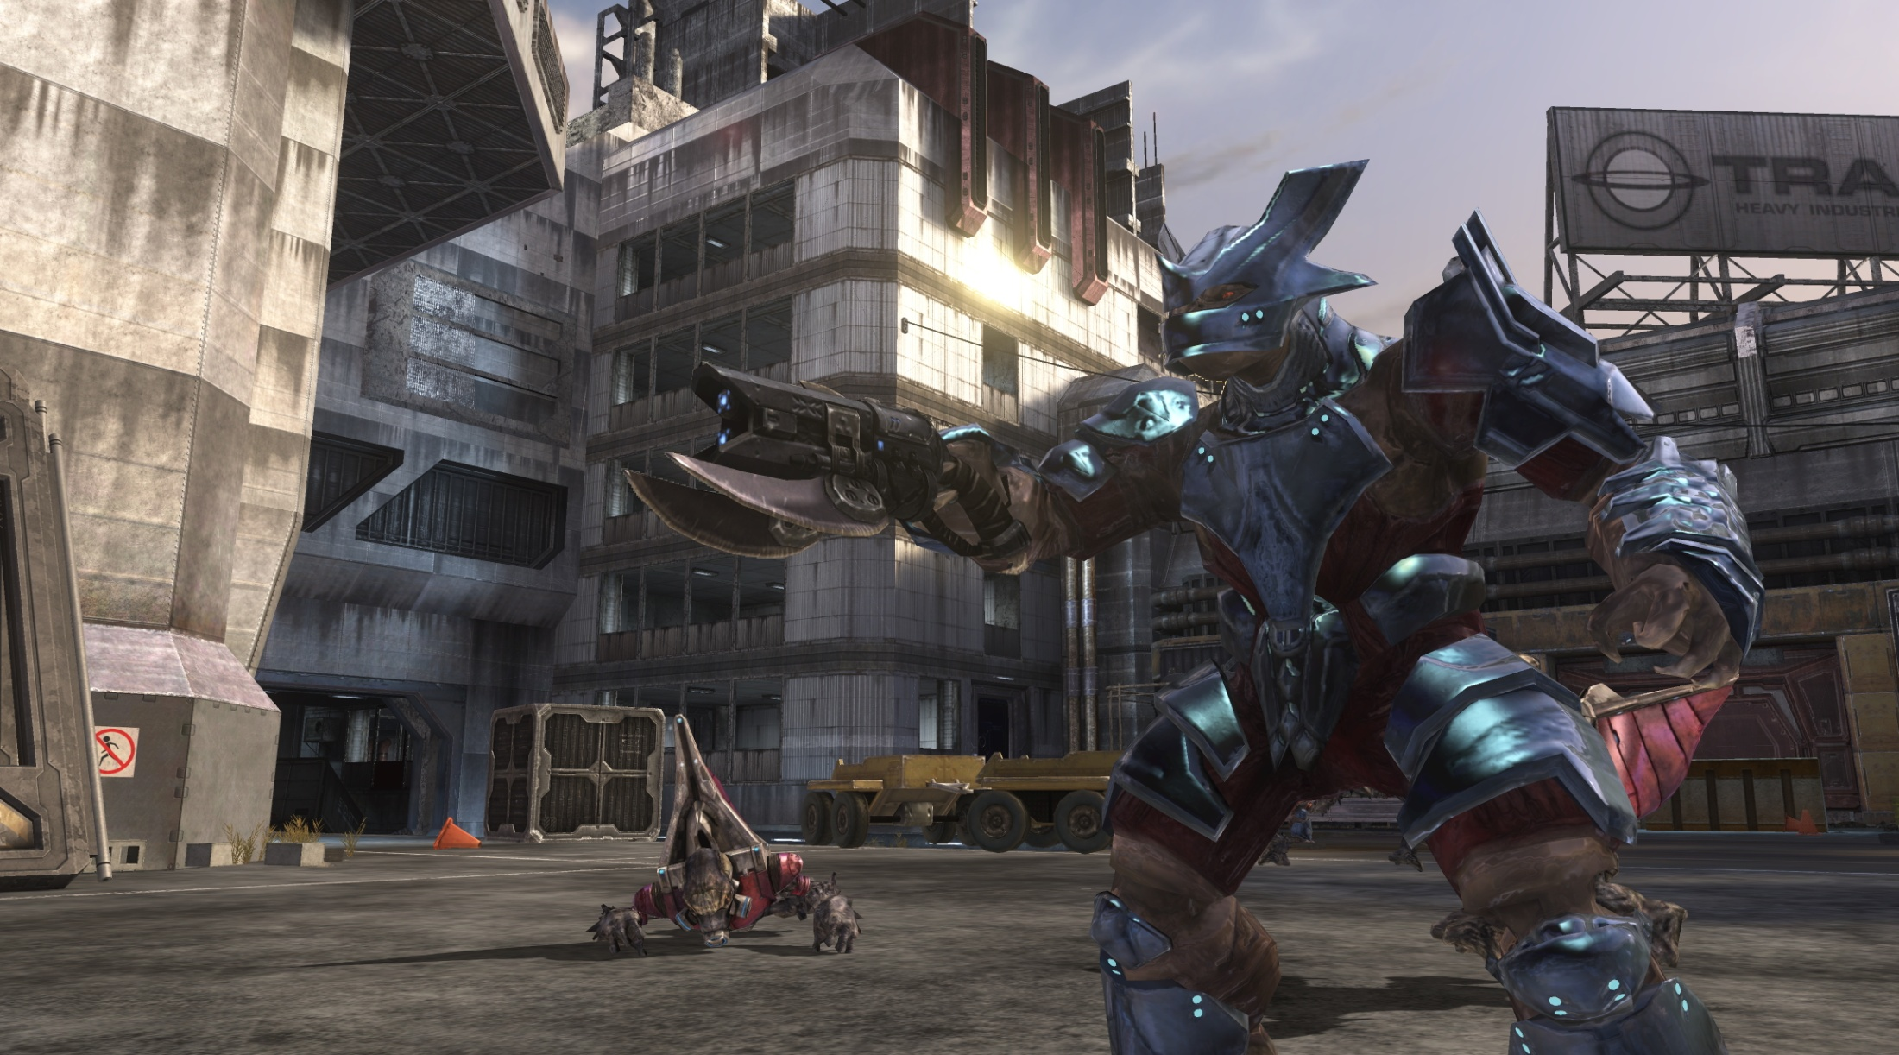

Slide 61
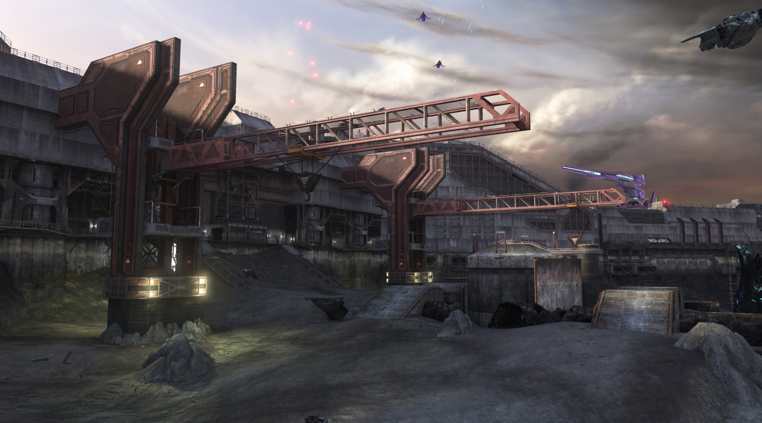

Slide 62
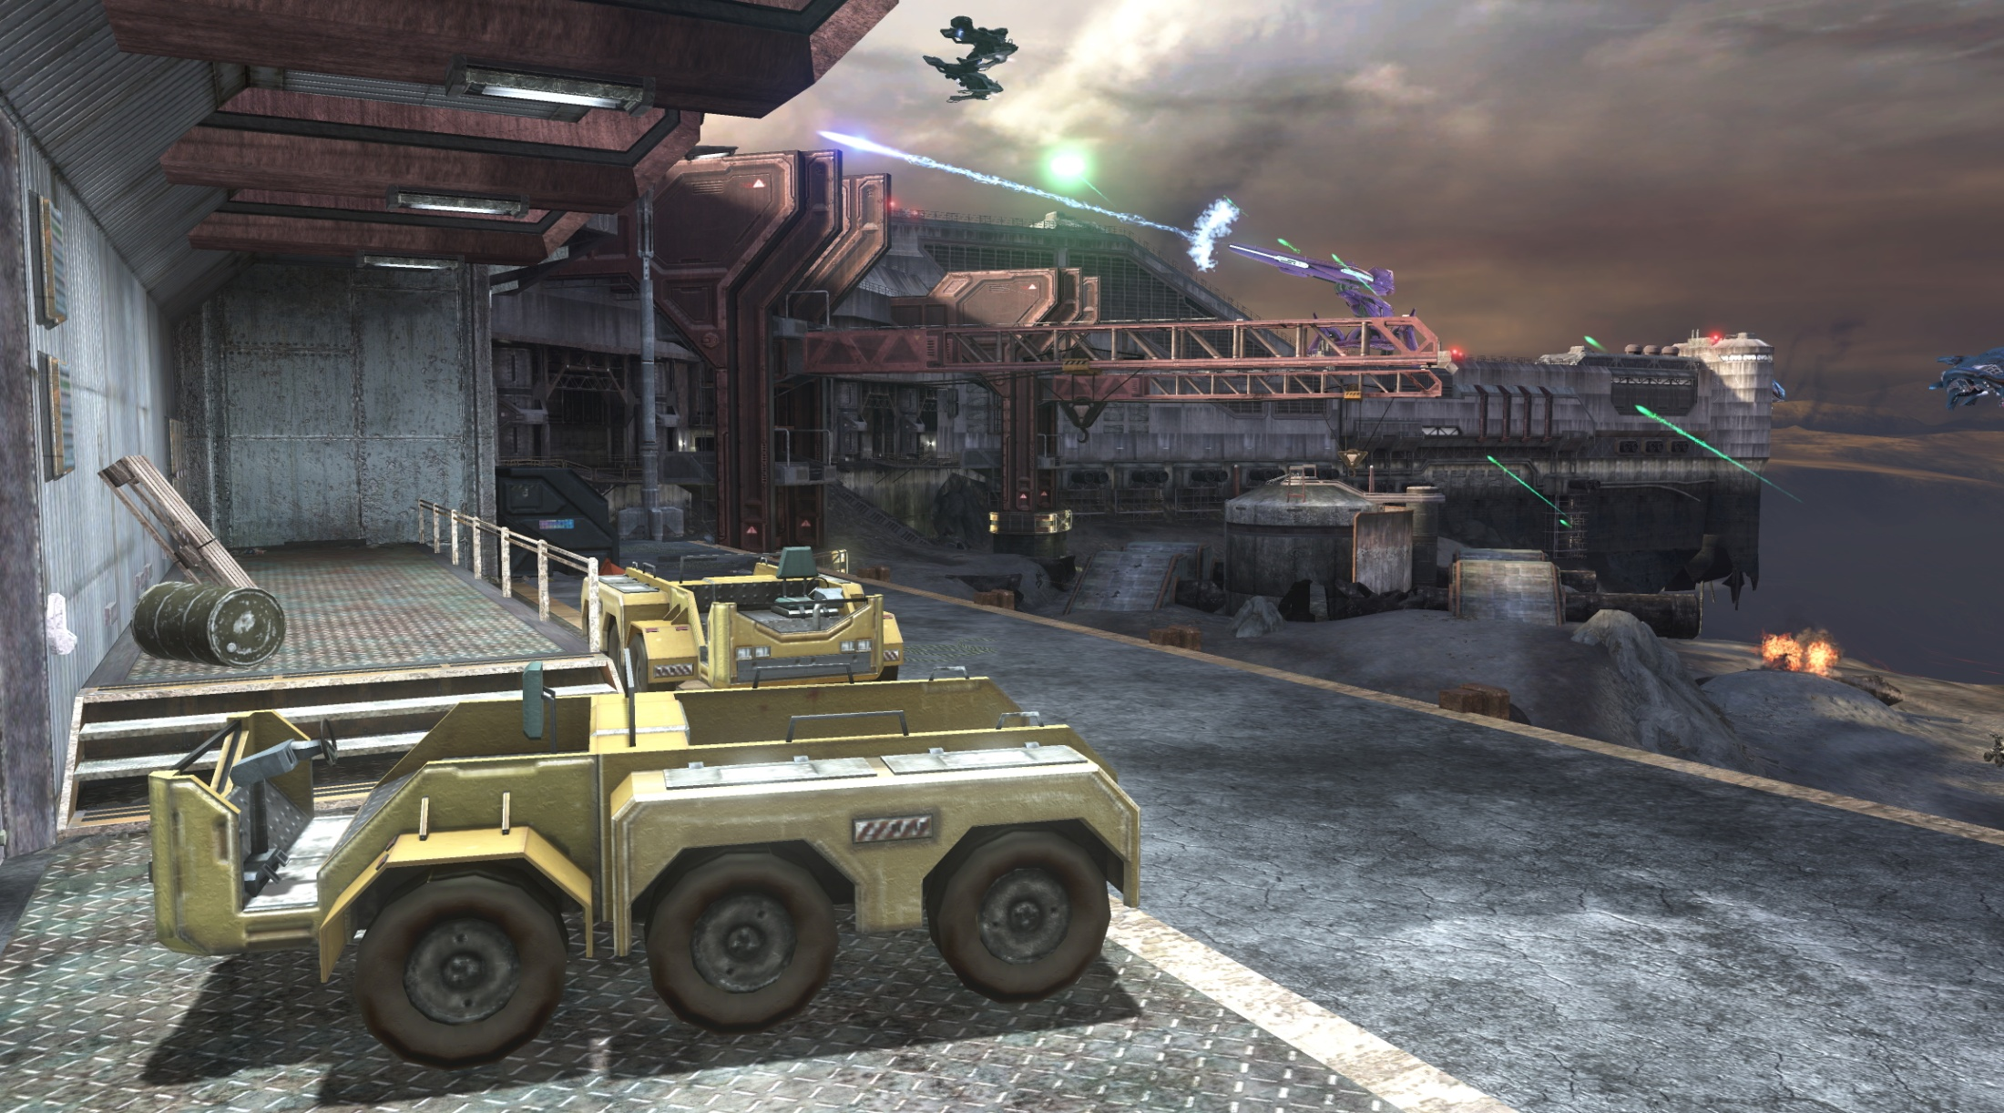

Slide 63
