Slide 1
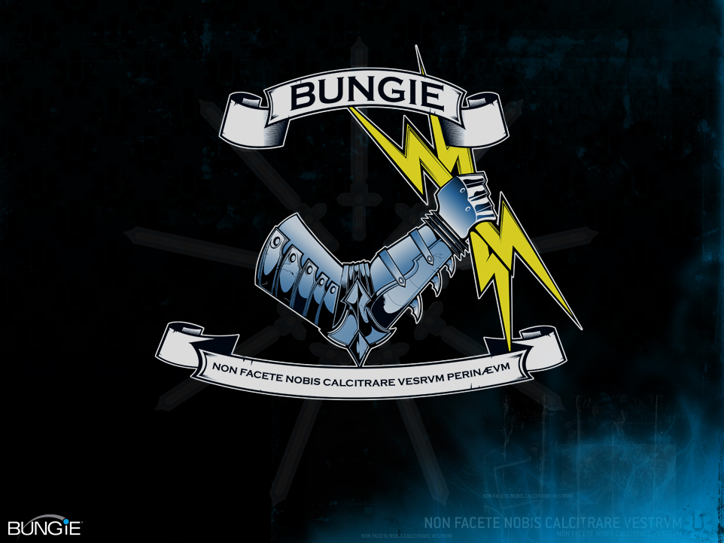

Slide 2
Life on the Bungie Farm
Fun things to do with 180 servers and 300 processors
Sean Shypula
Luis Villegas

Slide 3
What this talk is about
Server-side tools
Distributed asset processing
How these tools helped us make better games
How a system like this can help your studio
Notes:
This talk is about Bungie’s farm, which is a set of distributed systems that were used for processing assets during the development of Halo 3.
In addition to providing some implementation details and some things that we learned during the development of this system, we hope to show you how this system helped us to make better games, and how a system like this can help your studio.

Slide 4
Agenda
What is the Farm?
End User Experience
Architecture
Workflows
Implementation Details
Future
Your Farm
Notes:
Here’s a rough outline of the agenda for this afternoon’s talk.
-We’re going to first answer the question of what the farm is exactly, and we’ll show you what the farm does.
-We’ll show you the interface that the end users interact with,
-And then we’ll go through some of the implementation, starting with a high level architecture and a description of a couple workflows, all the way down through some specific implementation details.
-We’ll discuss a few improvements that we might be making to the farm in the near future,
-And finally give you a few tips for starting or improving upon a similar system in your own studio.
-We’re also going to have a Q&A session at the end, so please jot down or keep in mind any questions or comments and we’ll try to cover all of these at the end of the talk

Slide 5
What is the Farm?
Notes:
- What exactly is the farm?

Slide 6
What is the Farm?

Slide 7
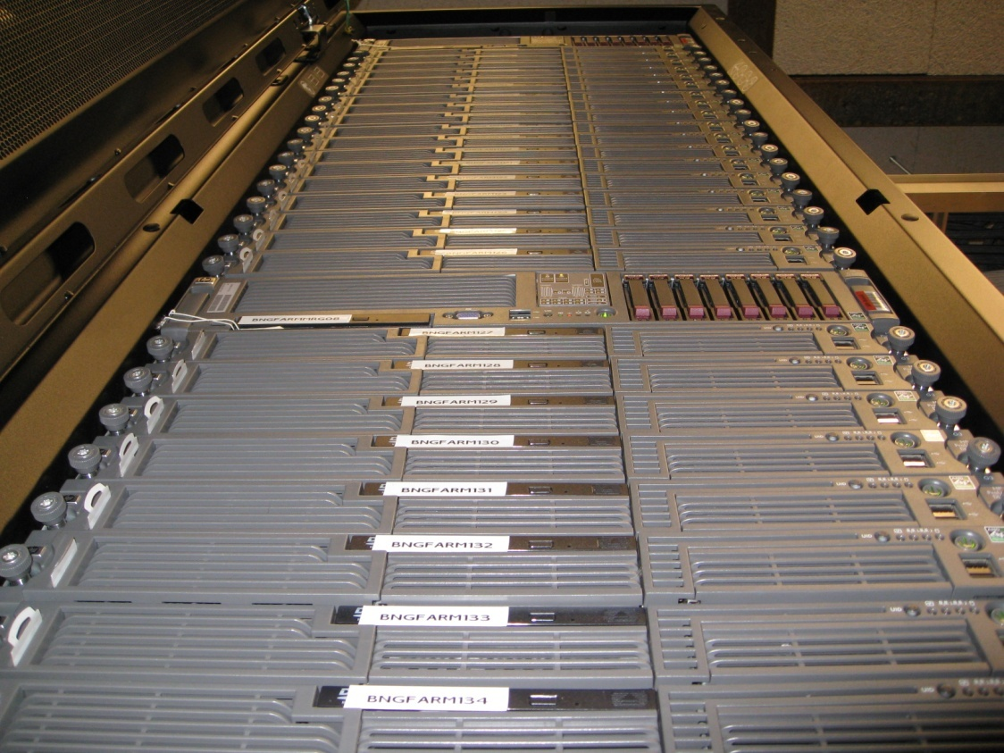
What is the Farm?

Slide 8
What is the Farm?

Slide 9
What is the Farm?
Client/Server based distributed system
Processes user-submitted tasks in parallel
System scales from several machines to many
Our farm is currently about 180 machines and 300 processors, plus a few Xboxes
Studios can still see major gains with only a few machines using a system like the one presented
Notes:
What we have in place is a distributed client/server system that is designed to handle complex and time consuming tasks by splitting them up and running the pieces in parallel. The system services an arbitrary number of these tasks on-demand as they are requested by members of the studio.
At the moment our distributed system uses about 180 rack-mounted machines which contain around 300 processors in total, and additionally has a small pool of Xbox dev kits.
This is a critical system at Bungie, and we have invested a lot in the physical resources as well as in development time. However, an investment of this size is not necessarily required to benefit from automation and distributed task processing. In fact, many studios can still see significant gains with only a handful of machines using a system like the one presented in this talk.

Slide 10
What Bungie’s System Does
Speeds up time consuming tasks
Faster iteration == more polished games
Automates complex processes
Not practical to run these workflows by hand
Automation reduces human error, keeps increasing complexity under control
Notes:
The first major advantage of having this system is that long-running processes can be completed in parallel in just a fraction of the time it would take to run serially on a single machine. For example, we have rendering tasks that would take many, many days to complete if they were run on a single machine, and these tasks can run from start to finish in just a few hours using our distributed system.
- Quicker turnaround time means that everyone working on the game can see the results of their work sooner and more frequently. A fast turnaround means more iteration, which at the end of the day translates into a more polished and refined game.
The second key advantage is that automation greatly reduces the complexity involved in the day-to-day tasks associated with making games. Many of the tasks that our system performs are fairly complex and require a large number of steps to complete, and for a member of the team to run these tasks manually on their development machines would be impractical and hugely inconvenient. Additionally, these tasks can be error-prone if they were run by hand, and our system eliminates any errors that might have been introduced by manual intervention. Through the use of automation, the studio’s most complex tasks from the user’s point of view are replaced by a single button press to request the job and an email notification sent out when the job is done and its results are available.
As time goes on the complexity involved in building game is only going to increase, and having a method of handling this complexity and keeping it under control is becoming an absolute necessity.

Slide 11
Main processes on “The Farm”
Binary builds
Game executables and tools
Lightmap rendering
Precomputed lighting
Baked into level files
Check out the talks by Hao Chen and Yaohua Hu
Content builds
Raw assets into monolithic level files
Several others
Notes:
Our distributed system has three main processes or workflows which are used the most frequently and by the largest number of users.
Binary builds include compiling our game executables and tools in a number of different debug and release configurations, as well as building a few other custom binary files used by the game at runtime.
Additionally, we run our tools through a few automated tests after the build is finished but before the binaries are checked in to make sure that there weren’t any blocking bugs introduced that could potentially affect the rest of the studio if the binaries were released.
Lightmap rendering is a fairly complex process where all of a level’s static lighting is precomputed and baked into the level files.
This workflow is by far the most resource-intensive task that the farm performs.
For more detailed information on our lightmap rendering process, please check out Hao Chen’s talk immediately following this one and Yaohua Hu’s talk tomorrow afternoon.
The third main process is content building, where our raw assets are built into monolithic level files.
Several others…
Shader compilation
Cubemap rendering
Builds of Bungie.net website
Several others
-We also have jobs that run on the farm that are used for machine maintenance, and these jobs for instance can apply OS patches and reboot, sync all the assets game to their most up-to-date versions, perform drive defragmentation and cleanup, and a number of other similar sorts of tasks.

Slide 12
The Bungie Farm
3rd iteration
Halo 1:
Asset processing mostly manual
A few tasks were automated
Halo 2:
Several different systems to automate and distribute complex tasks
Halo 3:
Unified these systems into a single extensible system
Notes:
Bungie’s distributed system is currently in it’s third iteration
At the beginning of Halo1, All asset processing was done by hand. When an engineer checked in code changes, they compiled on their development machine and the binaries that they built were then the official latest version of the game. Similarly, when an artist made lighting or geometry changes to their level, they rendered lightmaps on their local machine and left the machine alone until the lightmaps finished.
During the development of Halo1 we decided to set aside a couple of machines for running a few of these tasks, and we set up a small amount of automation to handle some of the intermediate steps.
For Halo2 we realized that a dedicated, partially automated content processing system was saving us a lot of time and effort, so we decided to completely automate the binary, lightmap, and content farms from end to end.
What we had by the end of Halo2 was three independent systems for these three distinct tasks, and in the Halo3 timeframe these systems were merged into a single system that can easily be expanded to a variety of different types of tasks.

Slide 13
Goals Achieved During Halo 3
Unified the codebases, implemented a single system that is flexible and generic
Unified server pools, one farm for all
Updated the technology (.NET), and made it easier to develop for and maintain
Notes:
- Again, one of the main goals we achieved during Halo3 is that we unified the codebases into single system that was designed to be flexible enough to handle any arbitrary task type that we would want to run on the farm.
Additionally, we unified the three distinct pools of machines into a single group of machines that can service requests for different job types based upon the machine’s specifications and any special requirements for the job.
We also rewrote the farm using .Net, with the goal of making the system very easy to develop on and to maintain.

Slide 14
What Our System Has Done
In the Halo 3 time frame, the current system processed nearly 50,000 jobs
Over 11,000 binary builds
Over 9,000 lightmap jobs
Over 28,000 jobs of other types
This has translated into countless hours saved in every discipline
We could not have shipped Halo 3 at the quality level we wanted without this system
Notes:
The farm was pretty busy during the development of Halo3. Throughout the course of the project our system processed over 50,000 jobs, and nearly 10,000 of those were lightmaps. If you take those numbers and multiply them out by the amount of time it would have taken an artist or an engineer to run them manually, what you end up with is a huge amount of time and effort saved, and this is all time that these people can spend actually doing what they’re good at.

Slide 15
End user experience

Slide 16
End user experience
Make it as easy to use as possible
User presses a button and magic happens…
Users get results back after the assets are processed
Even if your users are programmers, they still don’t want to understand how the system works
This is what the end user experience looked like…
Notes:
-One of the goals we had in designing the user interface for this system was to make it as easy to use as possible.
-We wanted the experience to be basically, the user presses a button, some amount of magic takes place, and after some time the user is notified that their job is done and that the results of their job have been made available.
-We wanted to hide as many of the details as possible from the end users, because ultimately what goes on under the hood is something that they don’t want or need to understand and we’d rather keep the details as something that the end user never has to even think about
-The following couple screenshots show what our end user interface looked like.

Slide 17
Notes:
Build site

Slide 18
Notes:
Color coding (build e-mail):
Any failures shown with red links to log files
Links to output folders and build reports

Slide 19
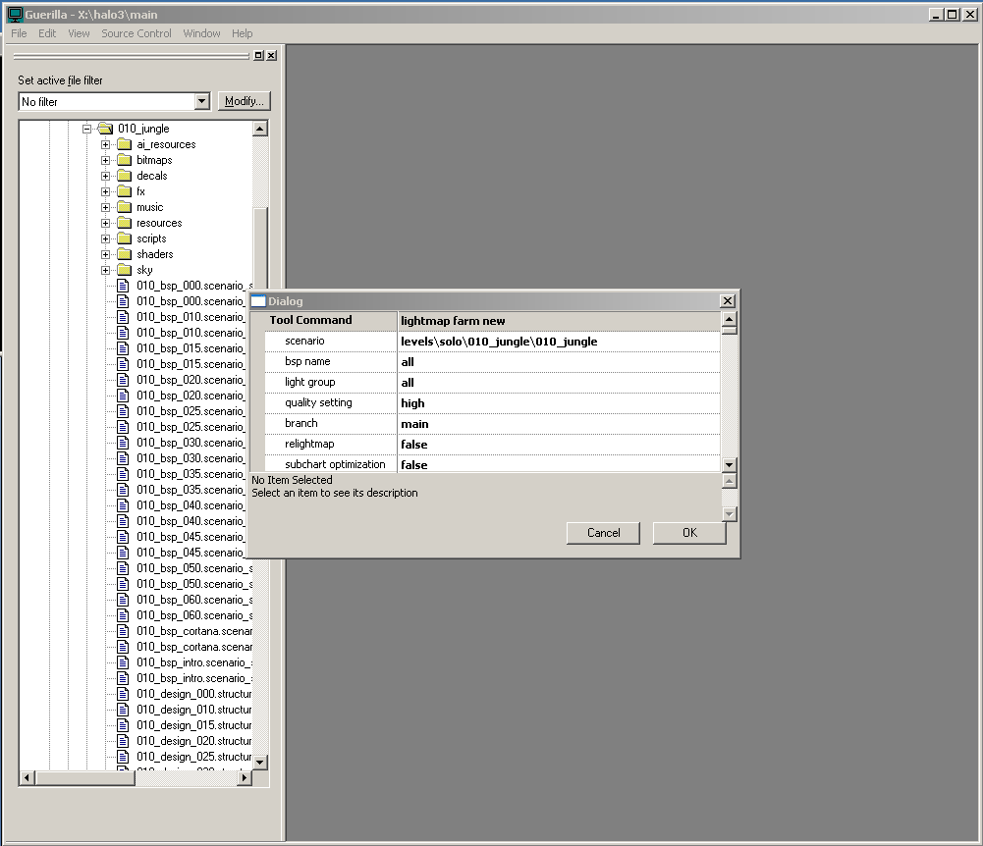
Notes:
Submitting a Lightmap Job

Slide 20
Lightmap Monitor UI
Notes:
This screenshot shows part of a web page that is used to display which parts of the levels of the game have up-to-date lightmaps, and what quality level those lightmaps were last run at.
This is really useful for artists since they can go to a single page and view the status of all the lightmaps in the game and are able to tell at a glance which sections need to have lightmap jobs run on them.
The page is updated in real-time by a process that is running continuously on a server. This process can also be configured to automatically submit lightmap jobs when parts of the levels are updated, which ensures that there is a minimal amount of time that those levels go without valid lightmaps. This was really useful when there was a lot of churn going on in some of the levels, since it meant that artists could continue to iterate without having to break out of their workflow in order to submit and monitor lightmap jobs.

Slide 21
Architecture

Slide 22
Architecture
Single system, multiple workflows
Plug-in based
Workflows divided into client and server plug-ins
Notes:
-As I mentioned before, this is a single system that is implemented as multiple workflows. -The system is heavily plugin-based, where each workflow is divided into separate client and server plugins.
-The client and server processes have some amount of code that handles loading and unloading of plugins and all of the lower-level stuff like communication and message handling, and all of the job execution logic and job state are implemented and contained in the plugins.

Slide 23
Architecture
Single centralized server machine, multiple client machines
Server sends job requests to clients
Clients process requests and send the server the job’s results
Server manages each job’s state
All communication through SQL
Notes:
- We have a very typical client/server architecture.
- Clients only communicate with the server, and not with each other.
Clients initiate jobs in response to server requests, send progress information back to the server as the job is being processed, and send a result message back to the server when its processing is finished.
The server also manages the state of each job and handles serializing and persisting that state while the job is not actively being processed.
-Another interesting architectural note is that all our communication is done through a SQL server, and I’ll go into more detail about that later on in the talk.

Slide 24
Information Flow
Server processes requests on the DB and sends task requests to clients by posting to the client’s mailbox
Web server posts requests to DB
Client only talks to the web server
Clients look for requests in their mailboxes in the DB, process them, and post results back to the DB
Server processes results sent by the clients
Notes:
This diagram shows an overview of the flow of information while a job is requested by the end user and then processed by the farm.
The end user interacts with the system through the web site. This interaction includes viewing information about currently active and completed jobs as well as the ability to submit new jobs.
Web server posts new job requests from the end user to the DB
Server processes active jobs in the DB and sends task requests to clients by posting messages to their mailbox
Clients look for task requests in their mailboxes, process the tasks, and post the results back to the DB
Server processes results sent by clients and advances the job to its next state if necessary

Slide 25
Workflows
Notes:
Now that we’ve covered the basic high-level architecture, I’d like to go over a few examples of some of the types of tasks that the farm performs.

Slide 26
Binary Build Site
Automates the code compilation for all configurations
Builds tools as well as the game
Builds other binary files used by the game
Automated test process to catch blocking bugs
Creates source and symbols snapshot
Notes:
The binary build site automates the process of compiling code for all our different configurations.
Our build site builds our tools as well as the game itself, and it builds a few other binary file types that are used by the game.
We also have an automated test process that is designed to catch blocking bugs, which are typically either crashes or hangs, before any of these binaries are made available to the studio.
-These are simple, quick tests that usually take about five minutes distributed across a couple of machines.
-Right now only our tools are tested, but we might add some in-game tests in the future.
-We also create a snapshot of the source tree and keep a copy of the build’s symbols, and I’ll explain how these are used in a minute.

Slide 27
Binary Build Site
Incremental builds by default
Configurations always built on same machine
Between continuous integration and scheduled builds
Devs run builds on-demand
Scheduled builds are run at night
Notes:
By default all our builds are incremental in order to make them as fast as possible. Each configuration is always built on the same machine to make sure that we only compile the code that has changed since the last build.
The system that we have in place is somewhere in between a system of continuous integration and scheduled builds. All of the builds that happen during the day are kicked off by developers through the web site. Additionally, we have automated full builds that run each night.
Moving to a system of continuous integration would be fairly easy, but we’ve found that the developers tend to prefer the on-demand system that we have now.

Slide 28
Debugging Improved by the Build Site
In Bungie’s past, game failures were difficult to investigate
Manual process of finding and copying files before attaching to a box
We wanted to streamline this process and remove any unnecessary steps
Notes:
Having a system set up to automate common tasks can allow you to do some pretty cool things, and here’s one example of how the farm had a direct and significant impact on our development process.
In the past, crashes and other failures were difficult to investigate. Debugging was a manual process of searching for files and copying them around before an engineer could attach to a box.
Debugging process:
Find out the build number, copy that build’s symbols and executables to a specific local folder
Find the path to the folder on the server that contains the source code for that build
Attach to the machine
Hope that symbols resolve
We wanted to streamline this process by removing the manual steps in order to make it as seamless as possible.

Slide 29
Debugging Improved by the Build Site
Symbol Server (Debugging Tools for Windows)
Symbols registered on a server
Registered by the build site once all configurations finish
Source Stamping (Visual Studio)
Linker setting to specify the official location of that build’s source code (/SOURCEMAP)
Set by the build site at compile time
Notes:
The solution that we found was to use a symbol server, which is a centralized server used to keep track of all the symbols for all the official builds that come off the build site. The symbols are registered by the build site once all the configurations finish building, and the symbol server keeps track of the version information. When an engineer attaches to a build that came off the build site, a matching set of pdbs is downloaded and all the symbols resolve automatically.
We also use a feature of Visual Studio called source stamping, which is a linker setting that is used to specify the final location on a server of the version of the source code that was used to build a certain set of binaries. The source is copied up to that location when the build finishes, and since that location is stamped into the pdbs Visual Studio knows that when it is debugging a build off the build site, it should pull the source from that location to use while stepping through the code.

Slide 30
Debugging Improved by the Build Site
Engineers can attach to any box from any machine with Visual Studio installed
Correct source and symbols downloaded automatically, everything resolves without extra steps
Very easy and intuitive process
Notes:
The end result is that an engineer can attach to any box from any machine with Visual Studio installed and the correct source and symbols are downloaded and resolved automatically without any manual setup steps required at all. You can step through the same set of code that went into the build and everything just works like magic.
- One example out of many where the farm has had a direct impact on the studio’s productivity.

Slide 31
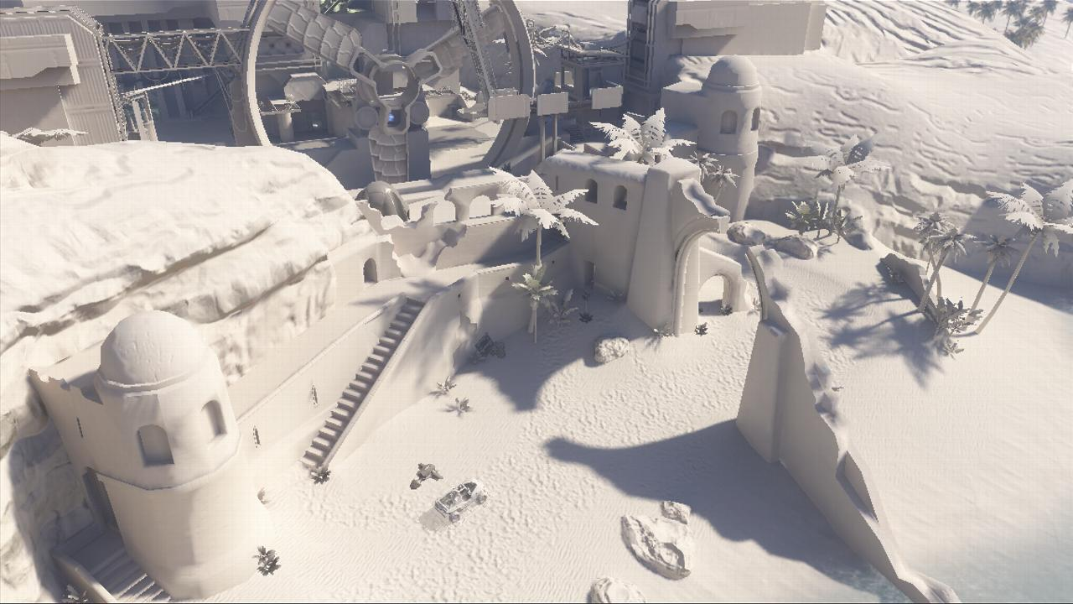
Lightmap Farm
The Farm
Notes:
-Again, lightmap rendering is a process of pre-computing all the static lighting in a level.
-The following few screenshots show scenes from Halo3 multiplayer maps rendered with default directional lighting only and what those scenes look like with lightmaps applied.

Slide 32
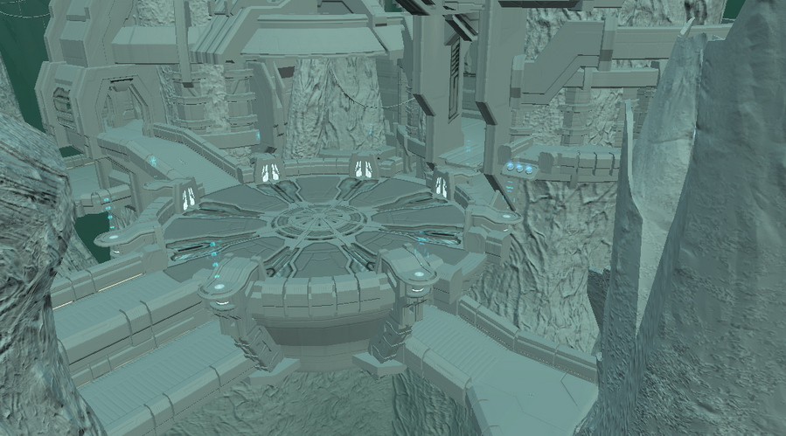
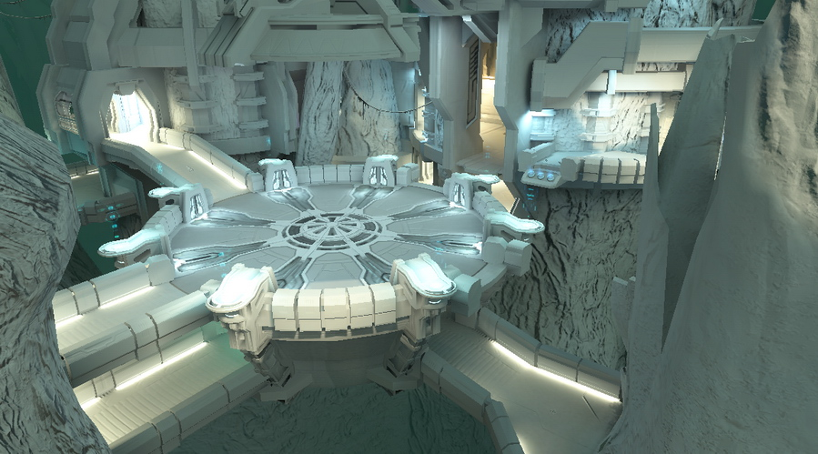
Lightmap Farm

Slide 33
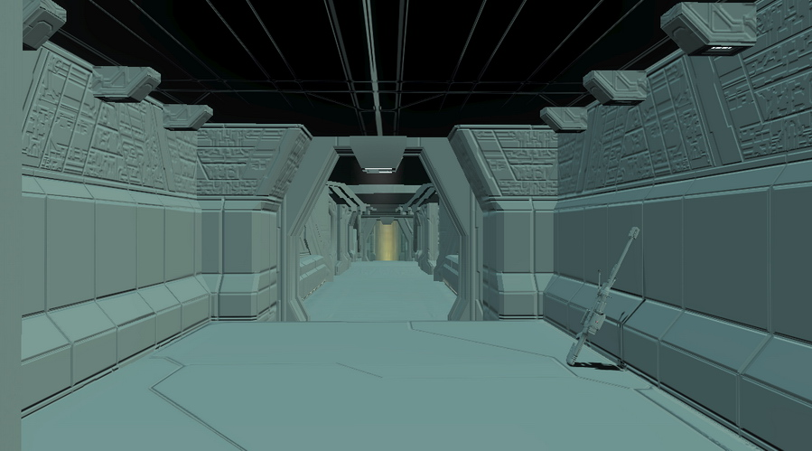
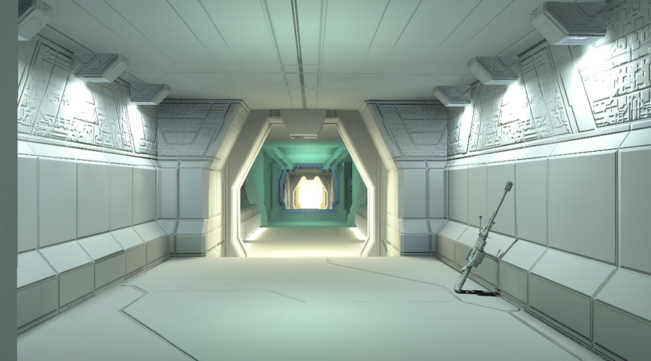
Lightmap Farm

Slide 34
Lightmap Farm

Slide 35
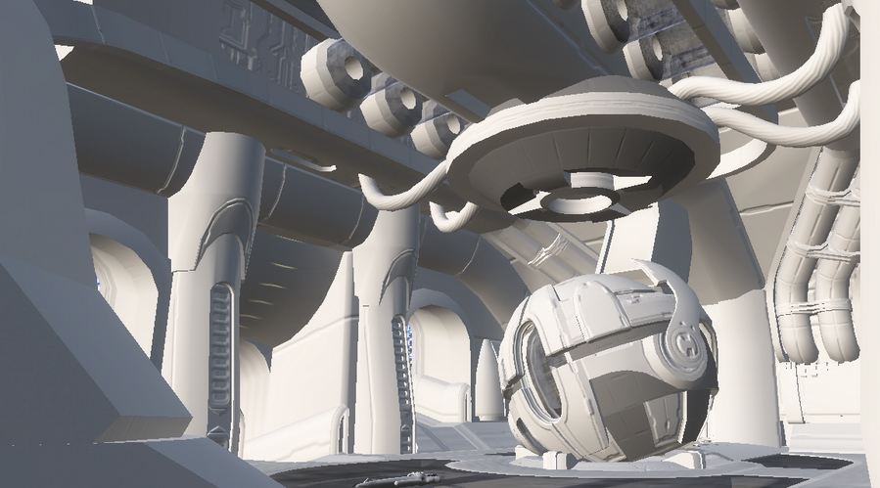
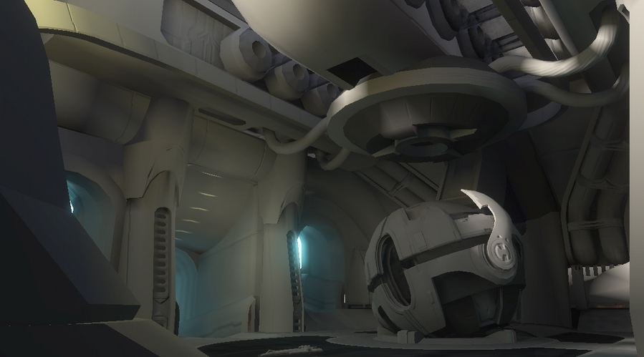
Lightmap Farm

Slide 36
Lightmap Farm
Very time consuming process
Initialization
Direct Illumination
Photon Cast
DXT Compression
Signal Compression
Final Gather
Notes:
-We have a multi-stage rendering pipeline where photon mapping used for bounced light
-Very time consuming process, can take several hours/days depending on the scenario
-Uses more resources than any other workflow
-The diagram here shows a very simplified view of our lightmap rendering pipeline, where the purple boxes show steps that are distributed across multiple machines.

Slide 37
Lightmap Farm
Lightmapper was written with the farm in mind
We can specify a chunk of work per machine
Merge the results after all servers finish
Simple load-balancing scheme
More machines used when fewer jobs are running
Min and max number of machines configurable per type of job and per step
Notes:
-The current version of our lightmapper was written specifically to be run on the farm.
-For each of the distributed steps we can specify the chunk of work we’d like to be run per-machine
-After all of these chunks finish we have a separate step that merges the results together
-We use a simple load balancing scheme that will allocate more machines per job when there are fewer jobs running
-The number of machines to use per job type and per step is completely configurable, which allows us to tune how these jobs are run to get the highest level of performance per machine and per job.

Slide 38
Cubemap Farm
Uses Xboxes and PCs for rendering and assembly
Small pool of Xboxes that are always available
Xboxes not running client code when not rendering
The farm scaled to Xboxes with few architectural changes
Notes:
-The final workflow I’d like to mention is the cubemap farm, which is used to render cubemaps which are used for rendering reflective surfaces in-game.
-What’s interesting about this workflow is that it required all the rendering work to be done on Xbox dev kits, so we ended up expanding the farm to include Xboxes in addition to rack-mounted servers.
-The dev kits are not running any sort of client code when they’re not rendering. Instead they’re controlled directly by other machines on the farm.
-This change was relatively painless to implement due to the flexibility that was originally designed into the system.
-We now use this pool of boxes for other farm tasks in addition to rendering cubemaps.

Slide 39
Implementation Details

Slide 40
Implementation Details
All code is C# .Net
This worked well for us
Here are some lessons we learned
Notes:
-First of all, all the code was written in C# with .Net, which is great for rapid development. We were very pleased with the decision to use C#, and we’re definitely sticking with C# for tools development for the foreseeable future.
-Here are a few things that we learned during this most recent iteration of the farm:

Slide 41
.Net XML Serialization
Objects serialized into XML to be passed around
There were a few issues with speed and memory use
.Net creates a dll for each new type and loads it into the AppDomain
Antivirus software sometimes locks files during serialization calls
Moved to Binary serialization which worked very well for us
Faster, uses less memory and storage in the database
Notes:
-Objects were serialized into XML in order to be passed around in messages, and we also serialized the state of each active job into XML in order to store it in the database.
-We used the .Net XML serializer for this, but there were a number of issues with speed and memory use.
-One of the problems is that .Net dynamically creates a new dll for each serialization type and loads it into the AppDomain, and this caused problems with memory consumption. In addition to this, antivirus software sometimes locks these dlls during serialization calls which was causing them to occasionally fail.
-We eventually moved away from XML serialization to binary serialization, which worked much better and consumed less space in the database.

Slide 42
Memory Management
We had a number of challenges keeping memory usage under control
Server would sometimes run out of memory
Garbage collection not as frequent or thorough as we’d like
A few things that helped:
Explicit garbage collections
More efficient serialization / deserialization (binary vs. XML)
Even though .Net manages your App’s memory, keeping memory usage in mind is still important
Notes:
Automatic memory management is one of the main features of the .Net environment, and it can be really useful in reducing code complexity. However, in large systems such as Bungie’s distributed farm, it is still necessary to keep memory management in mind throughout the design and implementation phases and to use the memory manager and garbage collector to your advantage.
For instance, we found that, especially on the server side, our memory consumption would often grow out of control and eventually cause performance issues and even crashes as a result of running out of memory.
We found that garbage collection would only happen under very high memory pressure, and frequently by the time the garbage collector kicked in our memory consumption was already high enough to be causing problems.
We were able to work around this by performing explicit garbage collections at key points during job processing, and by being more careful about how and when allocations were made (such as by switching from XML serialization to binary serialization, for instance).
The bottom line is that even though .Net makes the job of memory management easier for programmers, it is not a magic bullet, and keeping memory usage in mind is still very important, especially for large and demanding applications such as these.

Slide 43
Plug-ins
Plug-in based architecture worked very well
Each workflow implemented as a separate plug-in
Each plug-in exists in its own dll
Only the plug-in’s dll updated when the plugin changed
Notes:
-Again, our system was very heavily plugin based, and we found that this worked quite well.
-Each workflow was implemented as a separate client and server plugin, and each plugin exists in its own dll.
-When the plugin was changed only its dlls were updated.

Slide 44
Using Plug-ins to Mitigate Failure
Job failures isolated to a single dll
If a job or plug-in crashes, all other jobs are unaffected
Only a single active job kept in memory at a time
Inactive jobs are serialized into the database
Just remove the job and move on to the next one
Notes:
-One of the main benefits of using this sort of plugin based architecture is that it allowed us to mitigate problems associated with job failures or plugin crashes.
-Any time a failure occurred it was isolated to a single dll, and when any problems did come up, all the other jobs were unaffected.
-The reason this worked is that only a single active job was kept in memory at a time.
-As soon as a job is updated during an update cycle its state is serialized into the database before moving on to the next job,
-So when a job fails or there is a crash, we just remove the job and move on to the next one as if nothing ever happened.

Slide 45
SQL Messaging
Messages sent through a SQL database
Sender posts to a table
Recipient checks the table periodically
Messages sent to the recipient are removed and processed
Notes:
-As I’ve mentioned already, all messages are sent through a SQL database
-The way this works is that the sender posts a message to a table,
-The recipient checks the table periodically,
-And when the recipient finds a message addressed to it the message is removed and processed.

Slide 46
SQL Messaging
Benefits:
Transactional
Fault tolerant
Job wouldn’t fail if a machine rebooted
Drawbacks:
Difficulty scaling to many clients
Required maintaining a SQL server
If the SQL server went down, the whole farm stopped
Messages are not immediately received
Notes:
-The main benefit of a messaging system like this is the inherently transactional and fault tolerant nature of SQL Server itself.
-If a message was sent, we could be sure that it would always get through to the recipient, assuming that recipient was able to connect to the database. Since messages remained posted until they were received, we could have situations where a machine would go down or be rebooted, and this wouldn’t cause a job failure because the message would be picked up by the recipient as soon as it came back online. This was especially useful on the server side, since we could take the server down for maintenance without having to put the farm into an inactive or “paused” sort of state.
-This worked well for the most part, but there were a number of drawbacks.
The initial system worked well for a few machines, but did not scale well as the number of machines grew. Once the farm grew past a certain point, the database needed to be tuned to reduce the load on the SQL server which was beginning to grow out of control. This was not really a fault with SQL, and was more of an issue with how some of the tables were designed.
The main drawback here was that problems with the SQL server affected the entire farm. If the SQL server went down or needed to be rebooted, the entire farm was down until the SQL server was brought back online. In many cases, problems with the SQL server would lead to lost messages and jobs that would need to be cancelled and restarted.
Another issue was that messages posted to the database would only be picked up once the recipient got around to checking for pending messages, and as a result every message had a delay between when it was sent and when it was received. This wasn’t really a problem per-se, but it was an undesirable side effect.

Slide 47
Future Development
Notes:
- We have a number of ideas for potential improvements to this system that we’d like to investigate in the near future

Slide 48
Future Development
Dynamic allocation of machines for certain tasks
Ability to restart a job from a specific point
Improve administration tools
Create a test farm
Extend system to idle PCs
Notes:
-We’d like to be able to dynamically allocate groups of machines for specific tasks. This would be useful for scenarios where we’d like to make sure that there are enough machines available to get important jobs through the farm as quickly as possible while still being able to let other jobs go through. For instance, if we need to get a build or lightmap finished for a particular milestone, we’d like to be able to quickly set aside a chunk of machines that would only be used for that job.
-Another feature that we’d like to have is to be able to restart a job from a specific point. This would be really useful for cases where a job failed and we’d like to start the job back up from just before the point of failure so that we can debug the problem without having to start the job from the beginning and waiting however long it took for the job to get to that point.
-There’s a lot of work that can be done in the tools we have to work with farm. For example, it would be really useful to have some sort of graphical tool for managing client machines or to use for defining arbitrary job types.
-We’d love to have a small staging farm that we could use to test changes. Right now there’s a very limited amount of testing that can be done locally, and at the moment we pretty much just have to be very confident in the changes that are made, and once the changes are checked in we usually have to watch closely for a while to make sure that those changes aren’t having any unexpected side effects on the rest of the farm.
-Another major feature that we’d love to implement is to extend the farm to make use of idle PCs. There are a large number of PCs in the studio that are essentially idle for most of the day and pretty much all night, and if we could make use of these idle machines we could effectively double the amount of available processing power. Of course, there are a large number of challenges that we would need to tackle in order to get this working well enough for production use.

Slide 49
Future Development
New technologies in .Net 3.0:
Windows Communication Foundation (WCF) for communication
Windows Workflow Foundation (WF) for defining workflows visually
Notes:
There are a couple of new technologies that were introduced in .Net 3.0 that could be useful for the farm.
-Windows Communication Foundation, or WCF, is a communication framework that looks like very attractive alternative to the SQL messaging system we have right now.
-Windows Workflow Foundation, that’s WF and not WWF, is an interesting technology that is used for defining workflows in a visual manner from within Visual Studio. Because the farm is essentially a collection of workflows, this technology could be quite beneficial.

Slide 50
Implementing a Distributed Farm

Slide 51
Your Farm
Bungie has made a significant investment which has paid off throughout several titles
But you do not need a large farm to get the benefits of automation or distribution…
Probably do not even need to write the whole system yourself
Notes:
-It is important to remember that even though Bungie has made a significant investment in this system over the years, you don’t necessarily need to make an investment of this size in order to get some of the major benefits of automation or distribution.
-In fact you probably don’t even need to write the whole system yourself…

Slide 52
Farm Middleware Available
There are middleware packages designed specifically for this type of problem
If we were starting from scratch we would be doing tech evaluations
Most of these system either did not exist or were not mature enough when we started writing our system
See appendix for links
Slides available on bungie.net
Notes:
-There are a number of middleware packages out there that are designed specifically for this type of problem.
-If we were starting from scratch right now, we would definitely be giving some of these packages some serious consideration.
-Unfortunately most of these systems either didn’t exist or weren’t quite mature enough when we started writing our system.
-Check out the appendix at the end of this slide deck for a few links to some of these packages. These slides will be available on Bungie.net after the conference, and I encourage everyone to download the slides after the show and check them out.

Slide 53
Starting a Farm of your Own
Start small, use 1 or 2 PCs to run automated jobs
Automate first, distribute later
Automate simple but widely used tasks, grow the system slowly
Build process is a great system to start with
Focus on usability
Notes:
-Here are a couple of tips for starting a farm of your own.
-First, start off small. Use just one or two machines for running automated jobs.
-Automate first and then worry about distribution later. It’s much easier to get the system up and running from end to end without having to worry about distributing the workload, and you’ll be able to see some of the advantages of having the system in place much sooner.
-I’d recommend starting with simple but widely used tasks. The binary build system is a perfect system to start out with.
-And finally, try to focus on usability. One of the main goals is to relieve the headache associated with having the end users running these tasks on their own machines, so it’s really important to make the system as simple and easy to use as possible.

Slide 54
Idea takeaways
Automating repetitive tasks has a payoff no matter what the scale
Middleware solutions are available
Server side tools can have a huge impact on studio efficiency and iteration time
Bungie would not have been able to ship Halo 3 at the same quality level with out the farm in place
Notes:
-One of the main takeaways from this talk is that automating repetitive tasks can have a big payoff no matter what the scale.
-Middleware solutions are available, so it’s not completely necessary to write the whole system from scratch.
-And finally, asset processing systems like the one that was presented today might not be the sexiest or most exciting aspect of game development, but they can have a huge impact on studio efficiency and iteration time, to the point where Bungie simply could not have been able to ship Halo3 on time and at the same quality level without it.

Slide 55
Q & A

Slide 56
Appendix: Available Middleware
Digipede http://www.digipede.net
PipelineFX Qube http://www.pipelinefx.com
Xoreax Grid Engine (Incredibuild) http://www.xoreax.com
Windows Compute Cluster Server http://technet.microsoft.com/en-us/ccs/default.aspx http://msdn2.microsoft.com/en-us/library/microsoft.computecluster(VS.85).aspx

