Slide 1
Lightmap compression in Halo 3
Yaohua Hu
Bungie

Slide 2
Halo 3’s light probe textures
Spherical harmonic coefficients
It is large
Size: 1024x1024 (usually)
Each texel is a vector: 5*3 float values

Slide 3
Halo3’s lightmap compression
Signal compression:
Inter chart and sub chart optimization
DXT compression:
Two DXT textures for each SH coefficient channel

Slide 4
Key idea 1/2 - Signal based optimization
We optimize the sampling rate
Allocate less texels for low frequency area

Slide 5
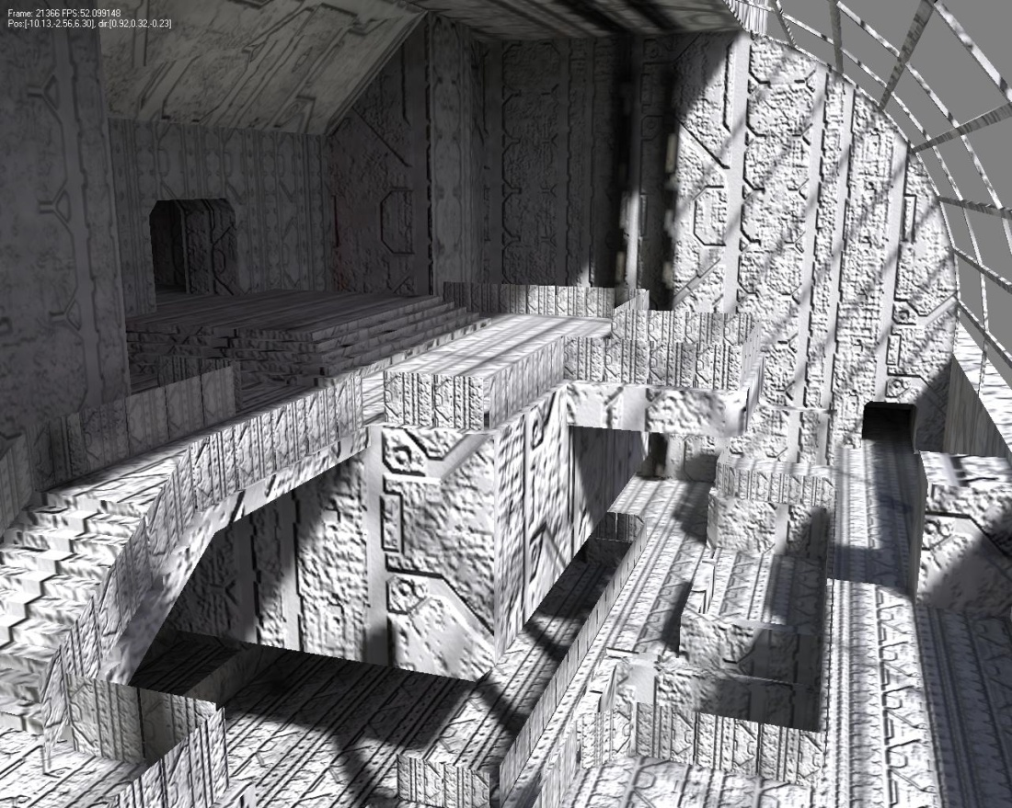
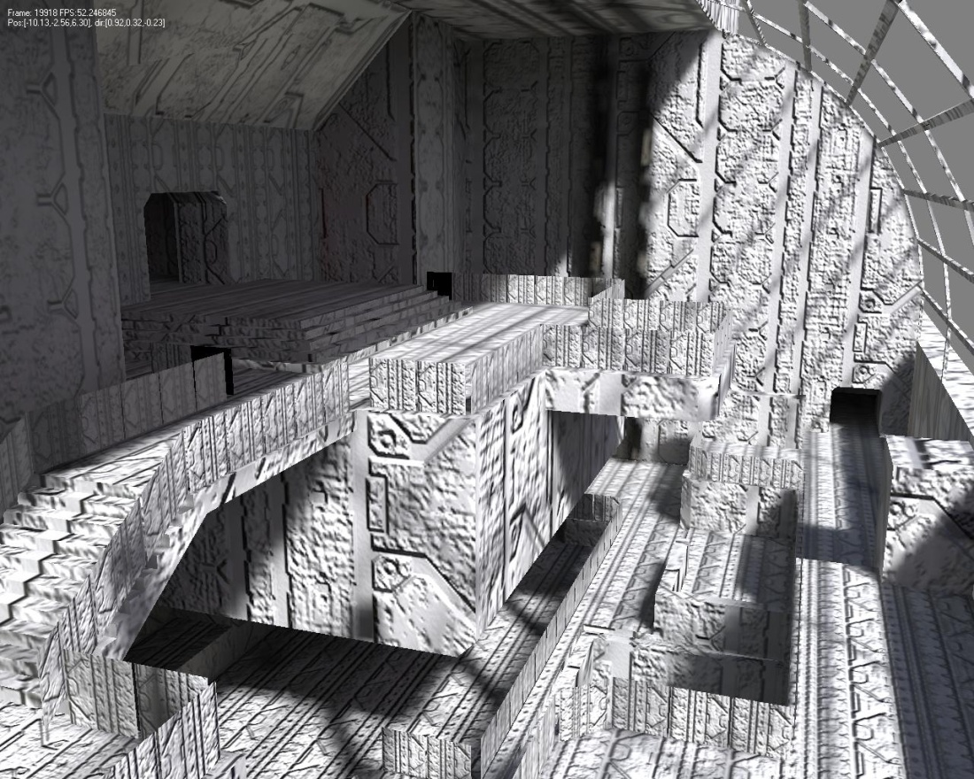
Initial result (2005)
Original signal:
Compressed to a quarter size:

Slide 6
Identifying the problem
The initial parameterization given by artist may not be optimal
We want to reduce the texture size automatically without very much visual quality degradation
No overhead at run-time

Slide 7
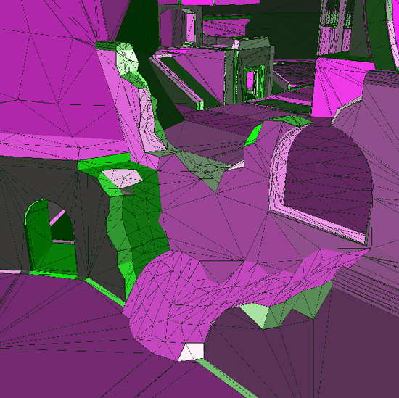
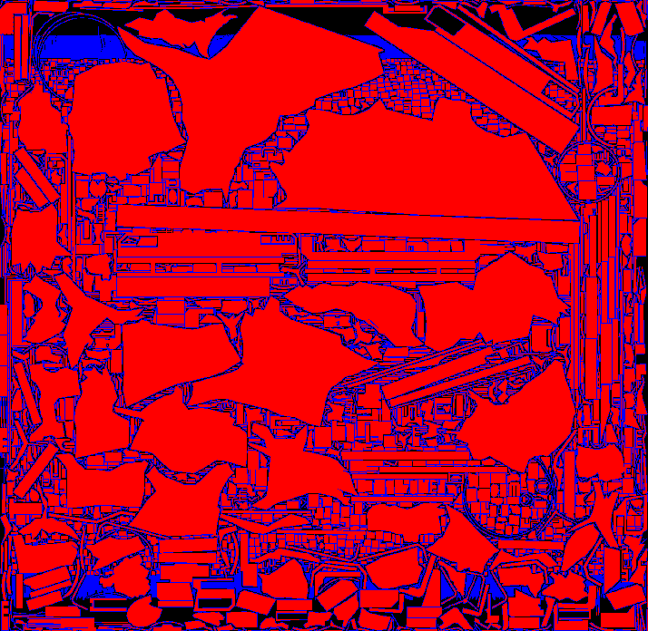
What we work with
Charts are our basic working elements
6018 charts in Zanzibar:

Slide 8
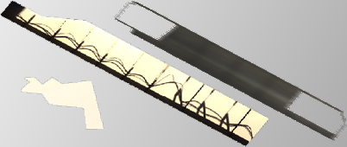
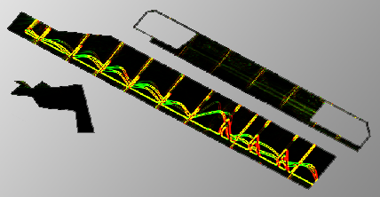
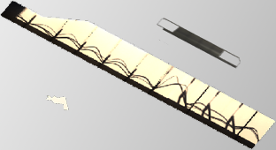
Inter chart optimization
Resize the charts based on their maximum gradient
Pack them to another lightmap with a smaller size

Slide 9
Signal analysis
Gradient in log space per channel per texel
x = log( L_l * L_l ) - log( L_r * L_r )
y = log( L_t * L_t ) - log( L_b * L_b )
Analyze the maximum gradient per chart
add the gradients of all SH coefficients per texel
The magnitude of the maximum gradient is the relative resizing ratio

Slide 10
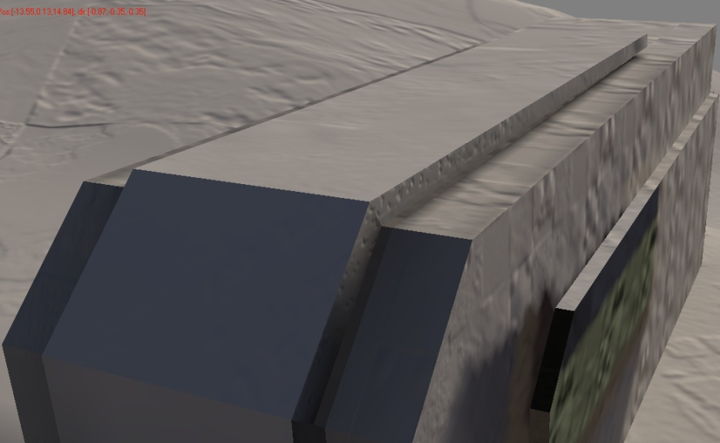
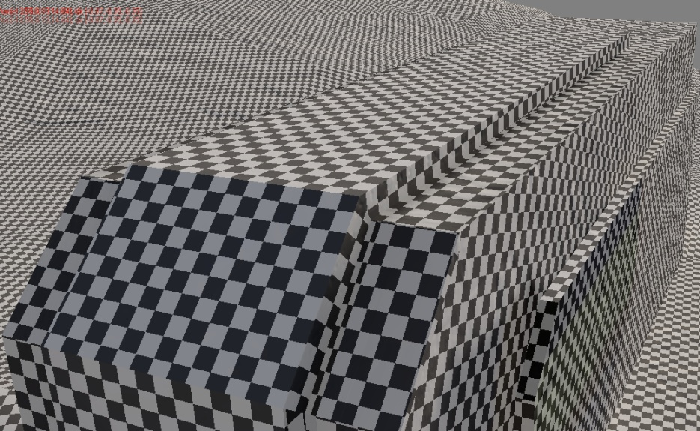
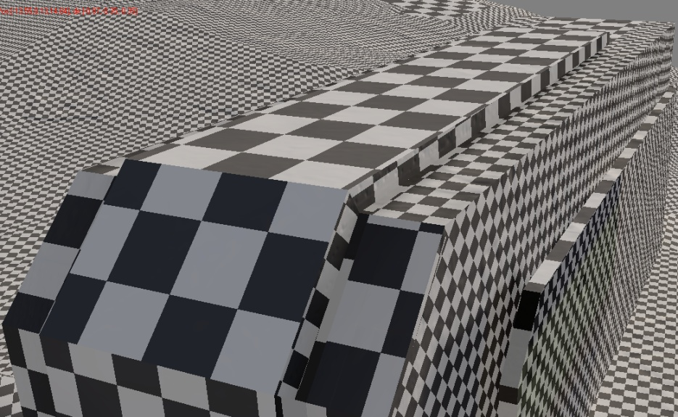
Top: lightmap on Zanzibar
Bottom left: artist’s output
Bottom right: optimized lightmap

Slide 11
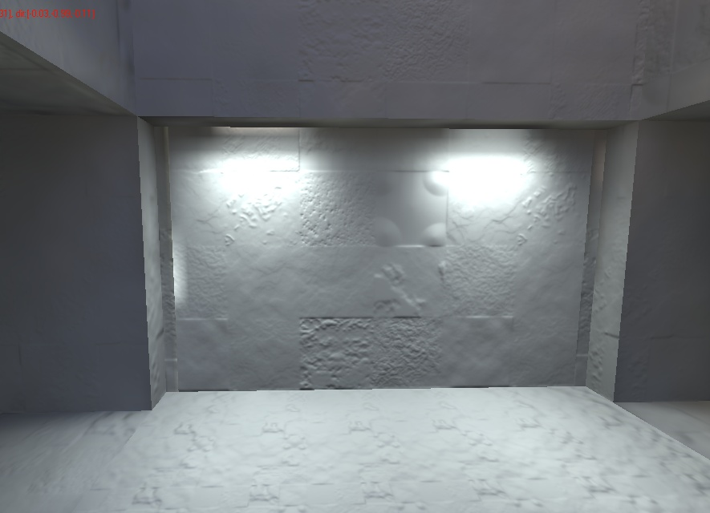
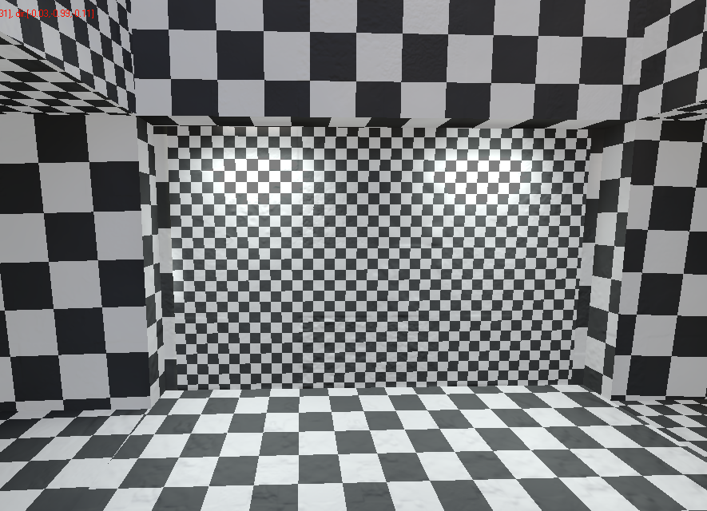
Top: lightmap on Zanzibar
Bottom left: artist’s output
Bottom right: optimized lightmap

Slide 12
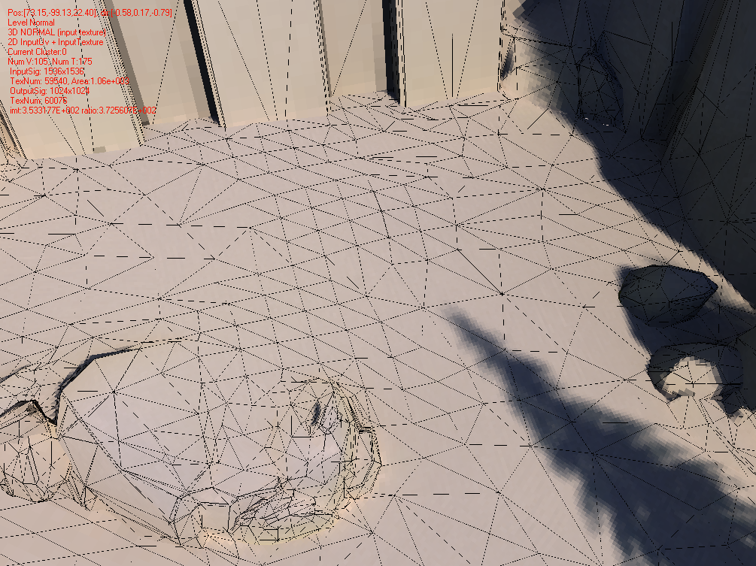
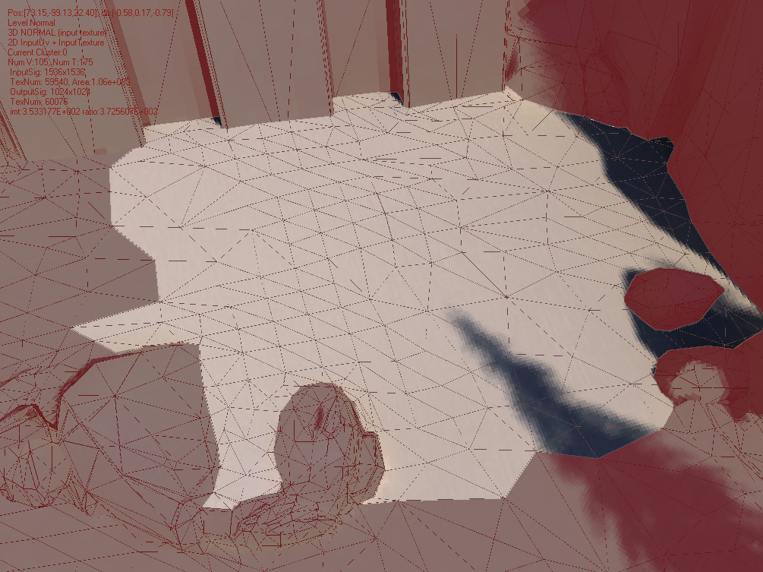
Sub chart optimization
Inter charts optimization is not good enough for big charts with only several high frequency triangles
Cut the connected low frequency triangles out of the original chart

Slide 13
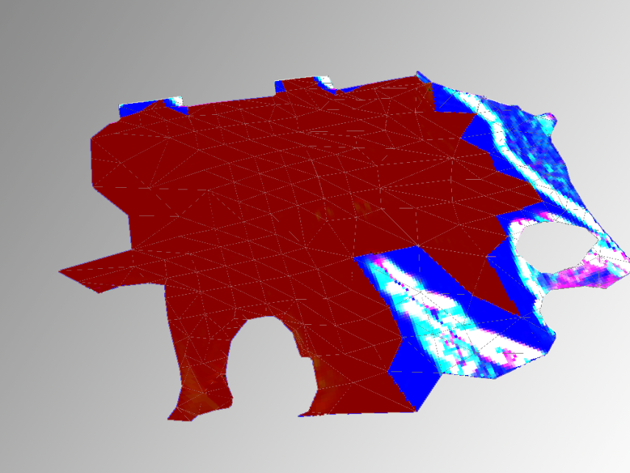
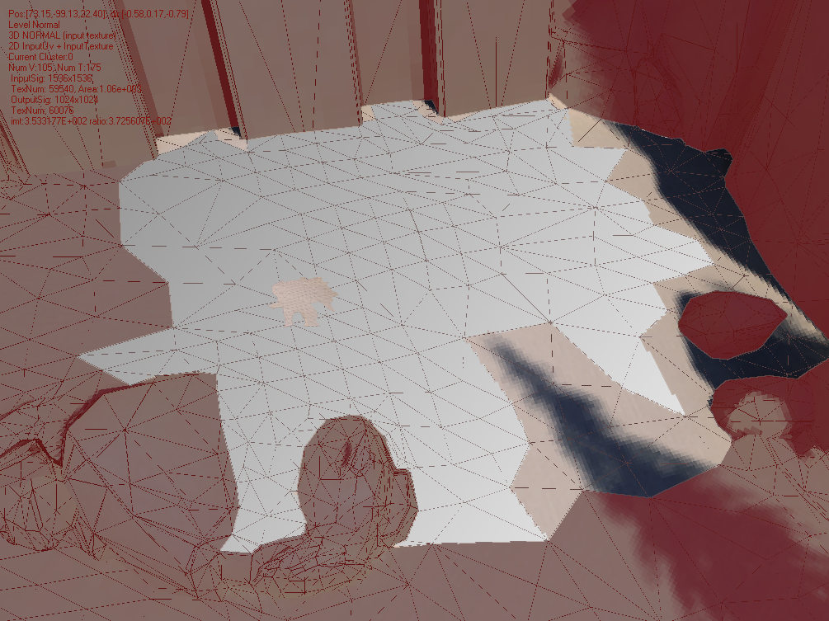
Top: One chart on Riverworld
Bottom left: signal analysis
Bottom right: optimized charts

Slide 14
Key idea 2/2 - DXT compression
Use two DXT5 textures to compress the SH coefficients (HDR, positive/negative)

Slide 15
“Luvw” space
Each band of the SH coefficients (RGB) are converted to “Luvw” space.
L: magnitude of the RGB vector
Nonnegative
Stored in DXT5’s alpha channel because of its better precision (3 bits palette)
Uvw: normalized vector
Has a good coherence usually when we store it in DXT5’s rgb channels

Slide 16
Luminance
Compress the square root of the luminance to have a higher dynamic range
Similar to log space, but it is cheaper to decode it

Slide 17
Luminance compression
Use the 2nd DXT to compensate the error ( L_block: input block )

Slide 18
Decode and result
Luminance = alpha0*alpha1*maximum_luminance
Result ( after 5x exposure )
Alpha0 *Alpha1
Alpha0 * Alpha0
Alpha1 * Alpha1

Slide 19
Color / uvw
Use the 2nd DXT to compensate the error ( RGB_block is the input block )
Decode:
RGB = ( rgb0 + rgb1 ) * 2 - 2

Slide 20
3 Dimensional compression
Signal compression:
Inter chart and sub chart optimization
Get smaller width and height
DXT compression:
Two DXT textures for each SH coefficient channel
Smaller space per texel

Slide 21
Misc Items
Use 2nd order derivative to analysis the signal
Intra chart optimization
Geometry optimization
Its effect on lightmap farm:
Resample or regenerate
Noise reduction
Use exp ( alpha0 + alpha1 ) if you need more

Slide 22
Acknowledgement
Bungie
Xi Wang ( DXT compression )
Microsoft Research Asia
Minmin Gong ( signal compression )

